Slide 1
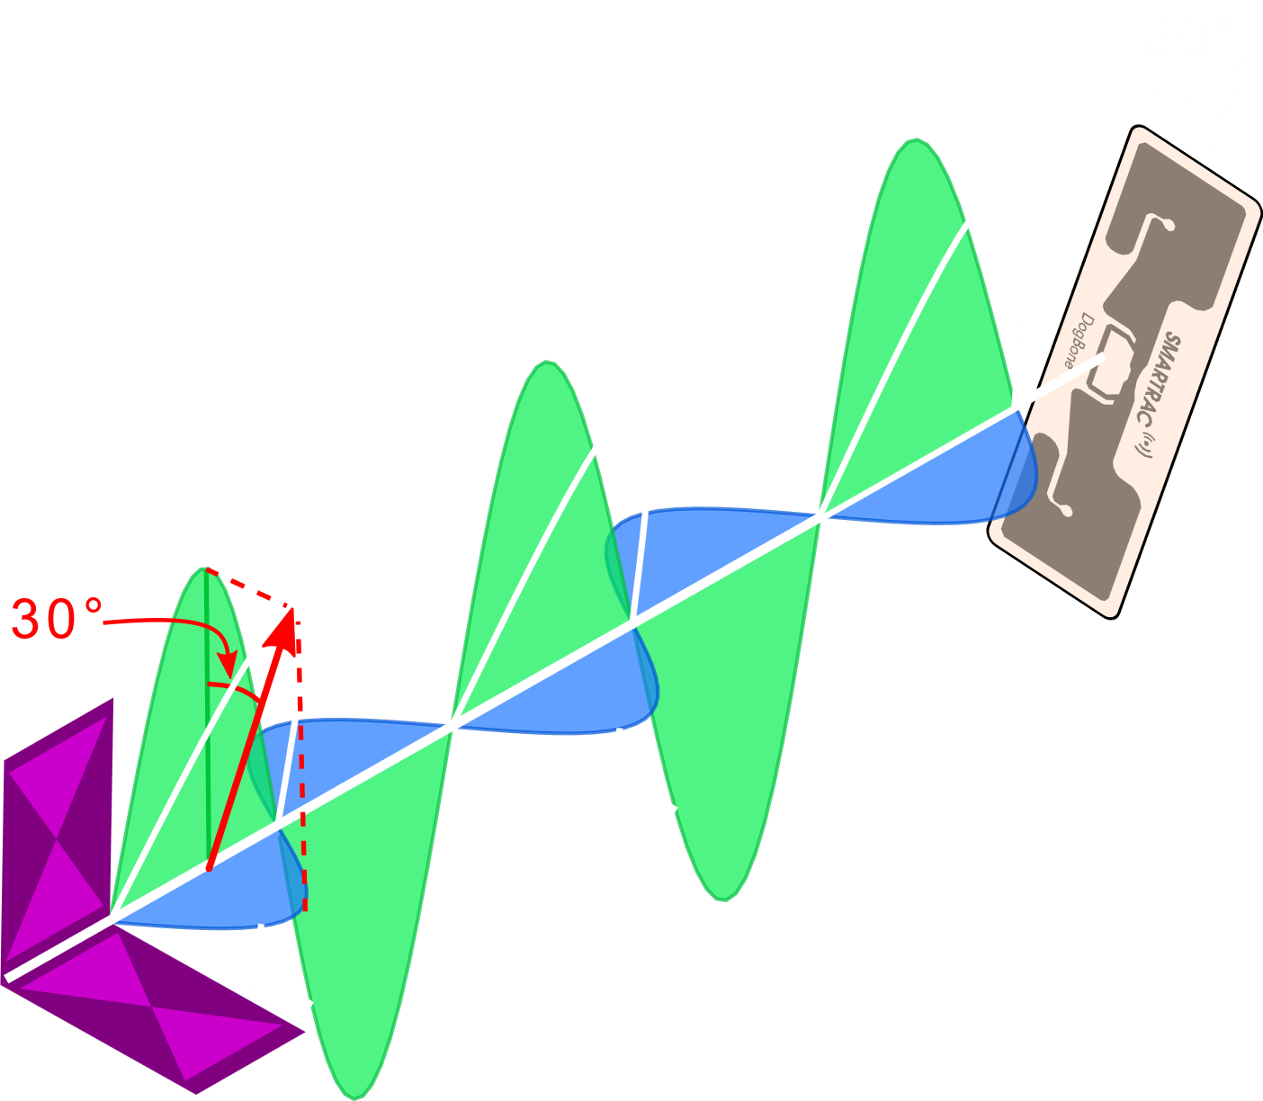
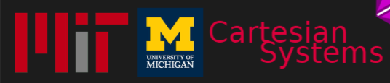
Software-Controlled Polarization for
Longer-Range RFID Reading & Localization
Laura Dodds
Nazish Naeem
Aline Eid
Fadel Adib

Slide 2
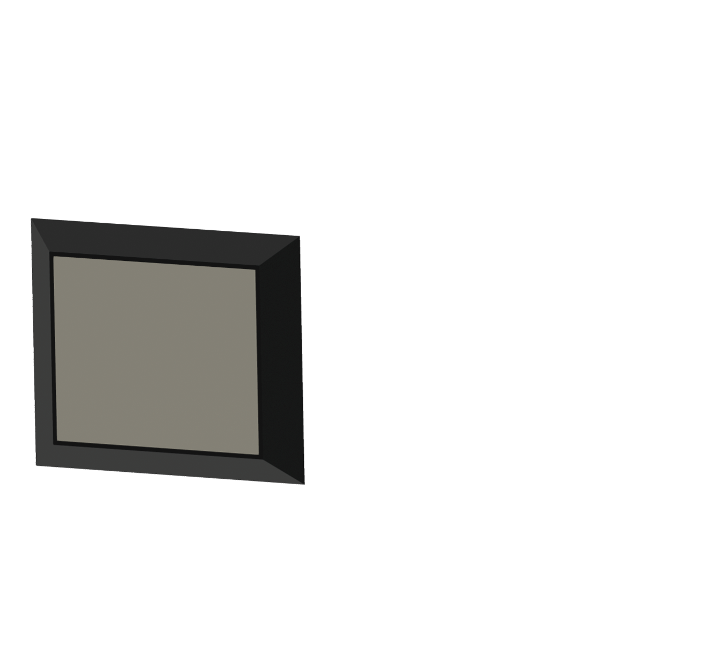
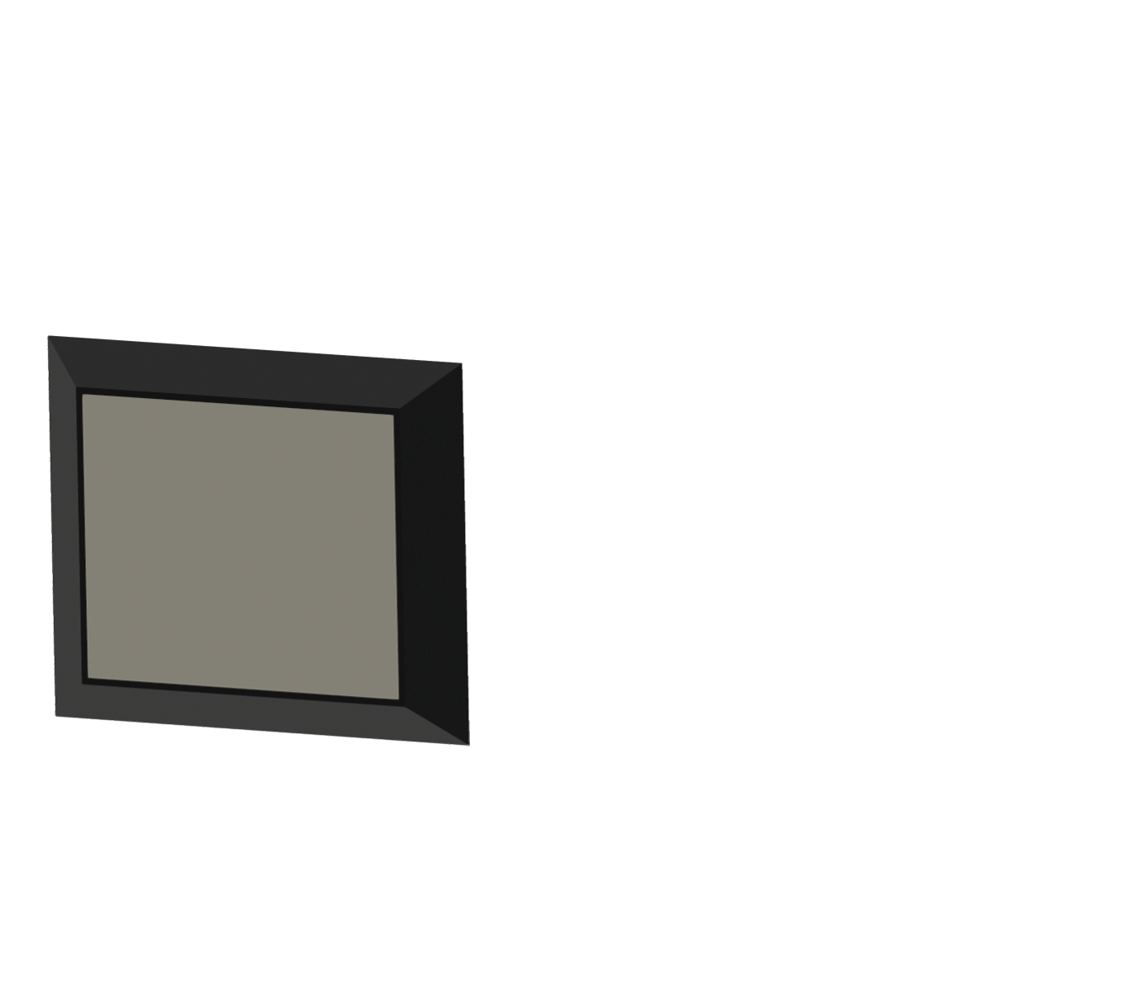

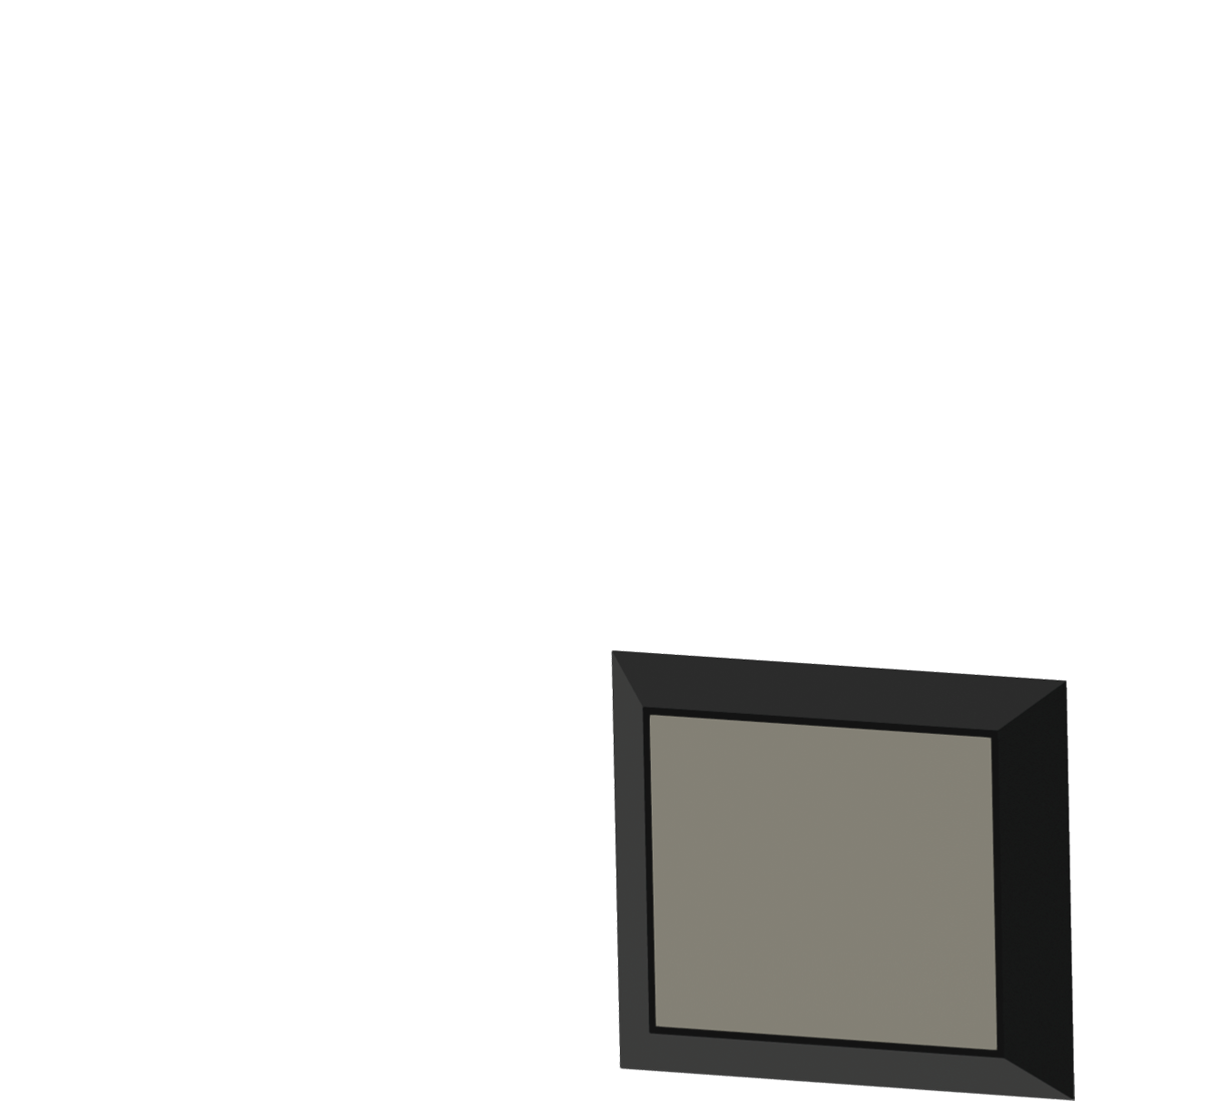
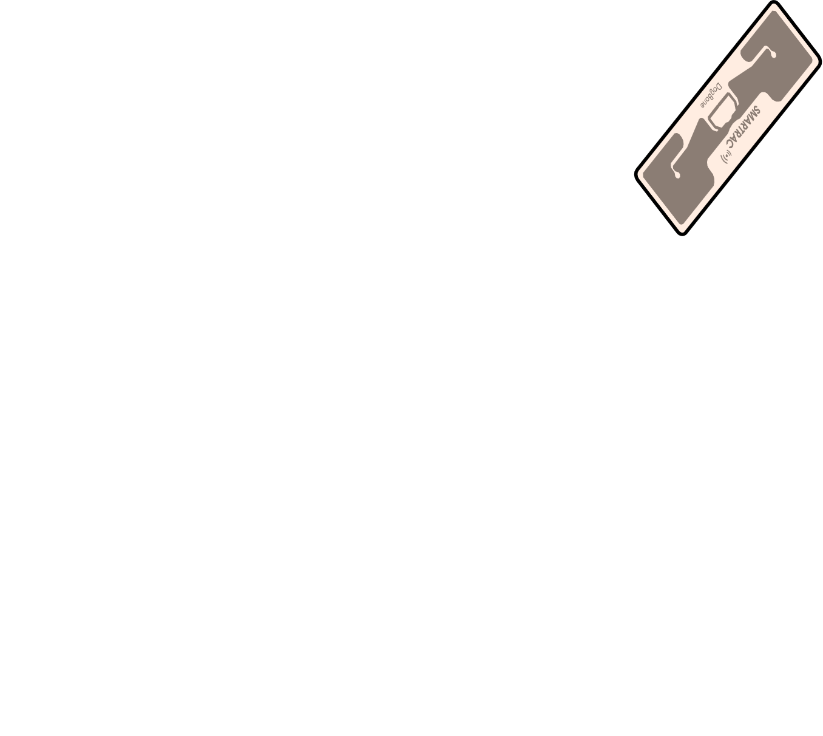


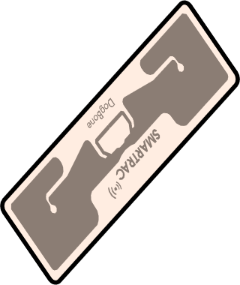




Current UHF RFID Readers
Switched Linear Polarization
Circular Polarization
-6dB
-6dB @ 45°

Slide 3



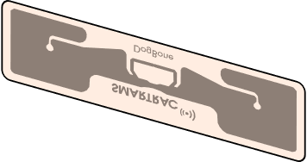
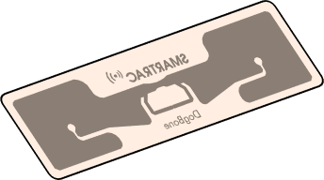
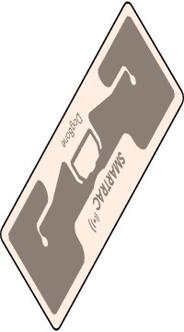
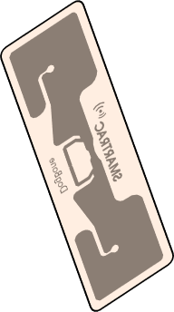
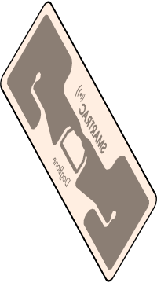





How to achieve ideal polarization?
0dB loss

Slide 4
RF-Boost
Introduce software-controlled polarization to extend read and localization range
Develop techniques for efficient discovery protocol and dynamic power adaptation
Reduce blind spots by 4x and boost SNR by 6dB
Boost cm-scale localization range by 1.3x

Slide 5

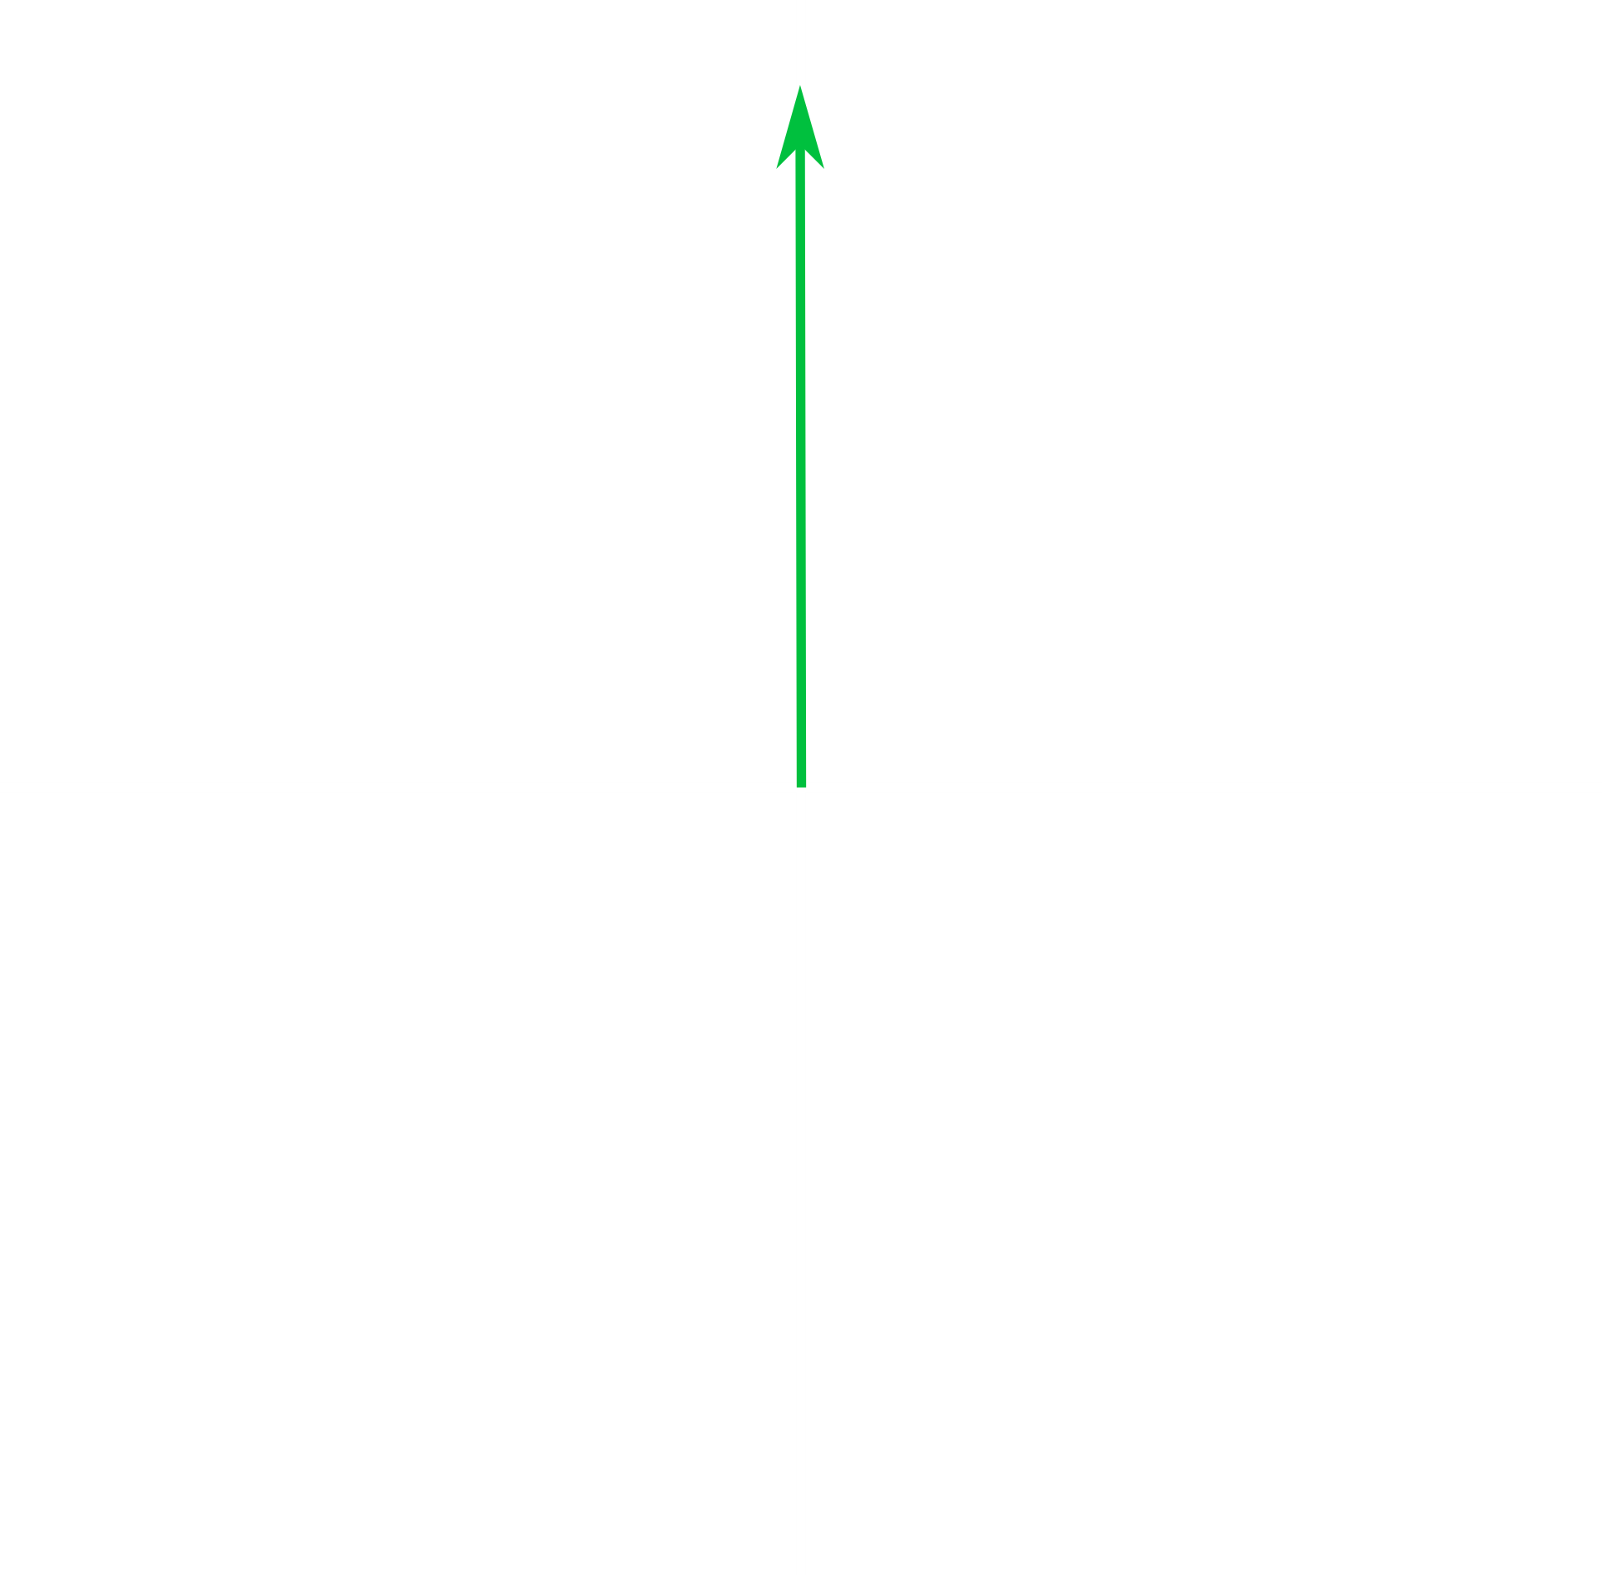
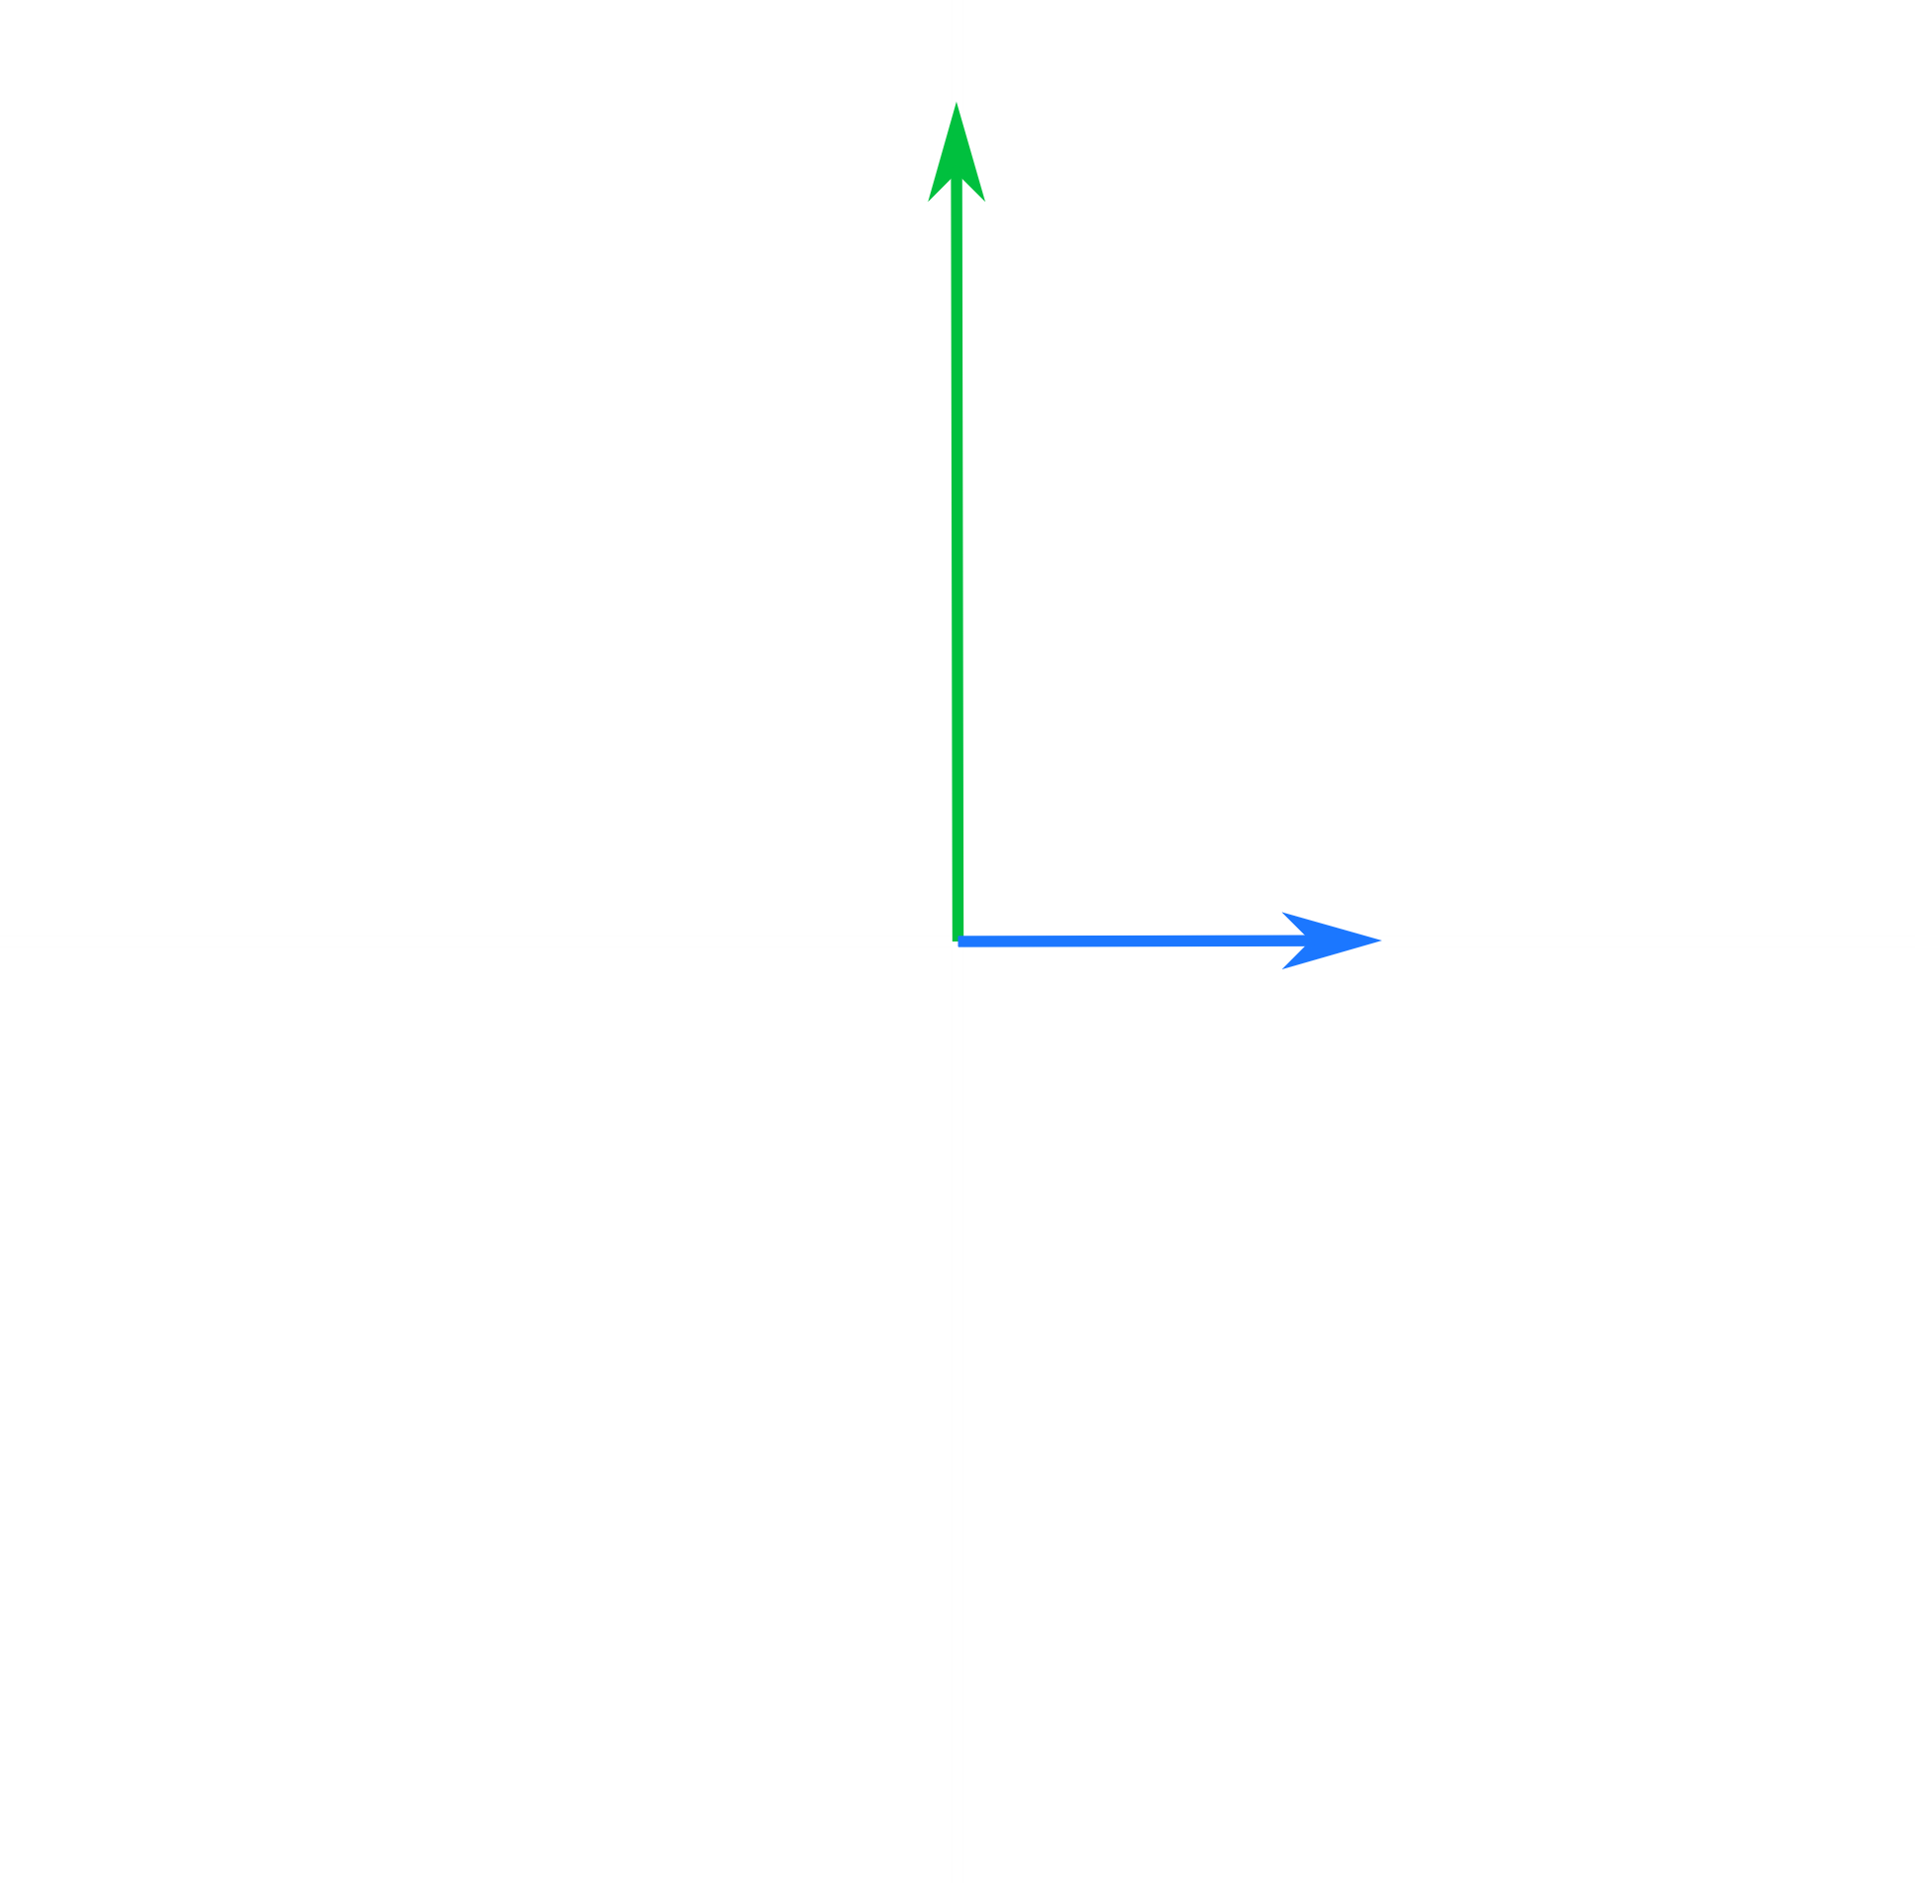
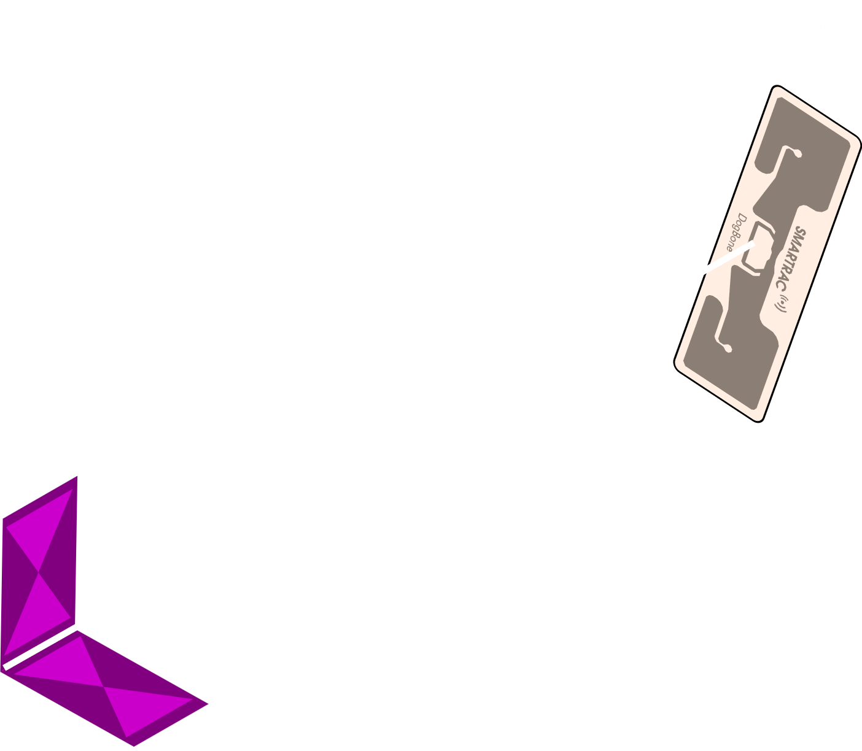
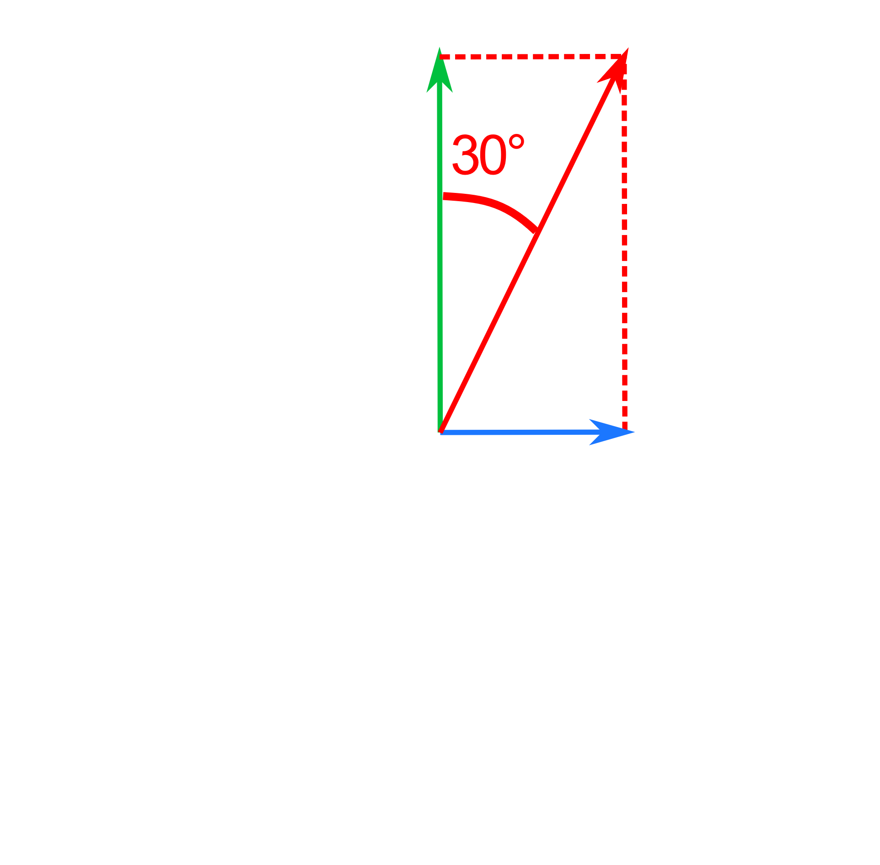
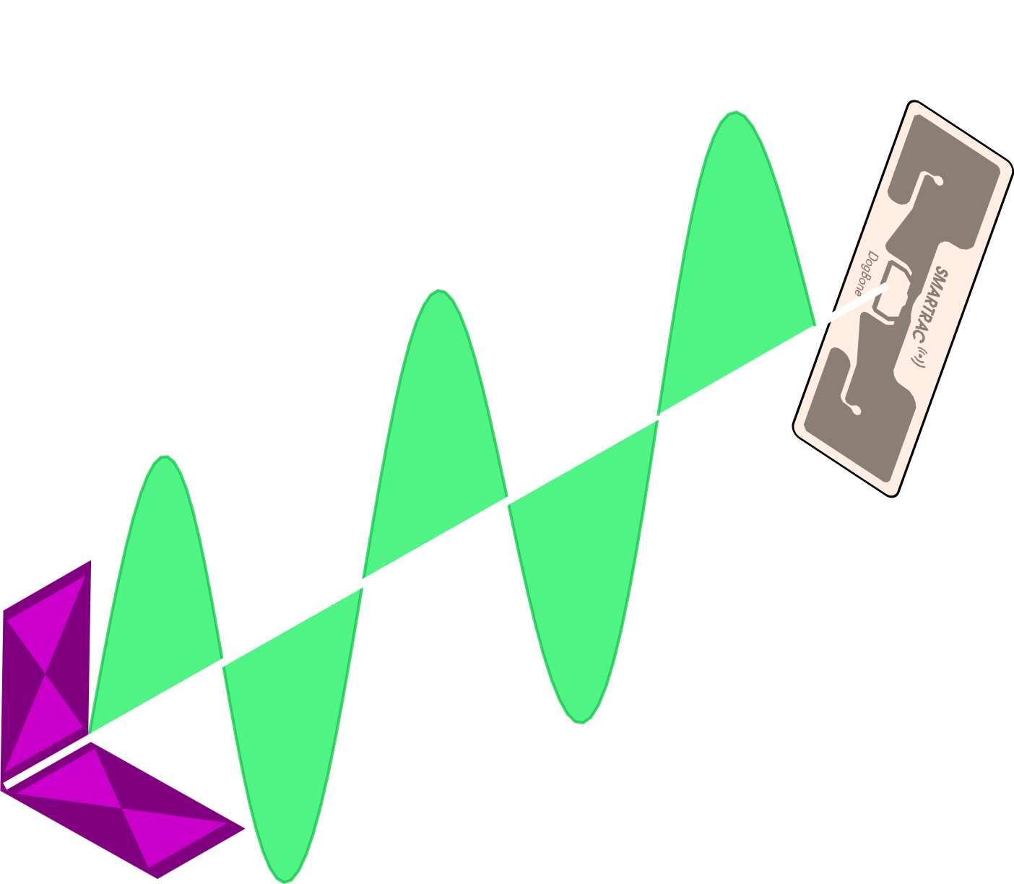
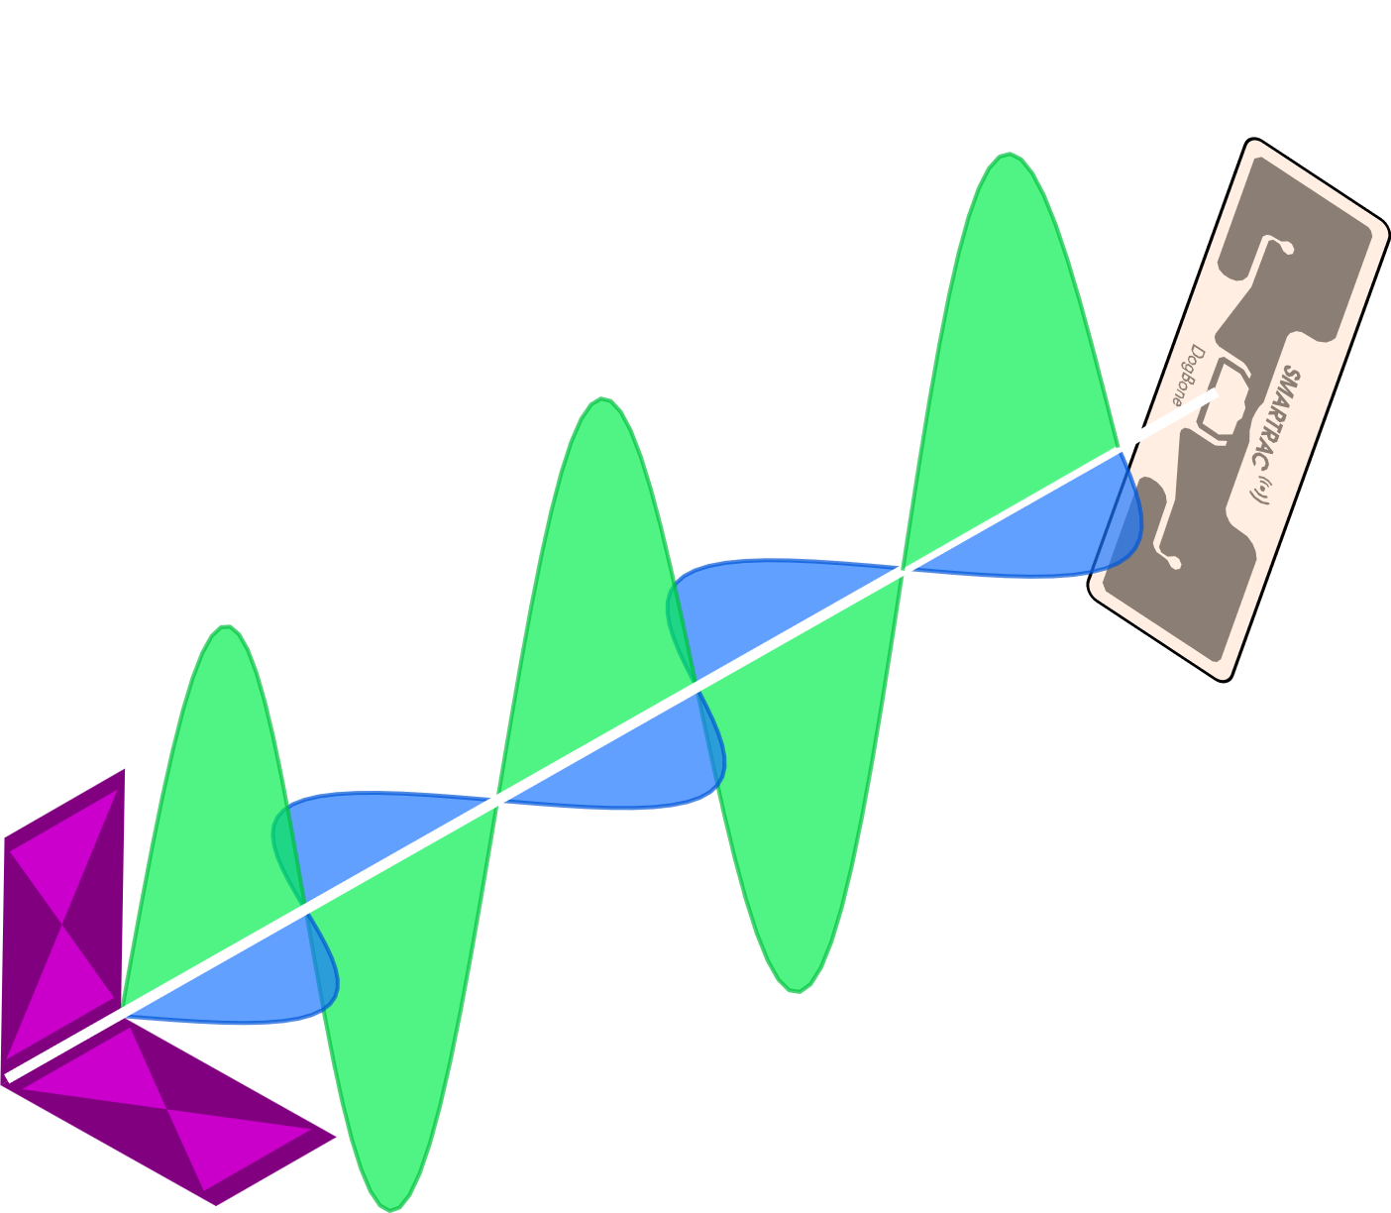

Software Controlled Polarization
Amplitude Control w/ Two Linearly Polarized Antennas
Software controlled polarization can minimize
polarization loss
0dB loss
Challenge: Tag angle is unknown
Vector Representation

Slide 6
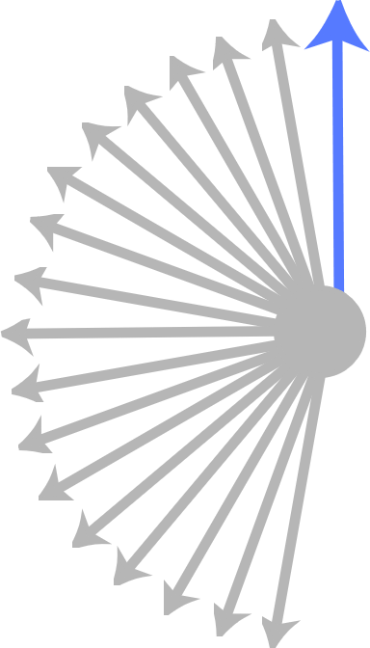
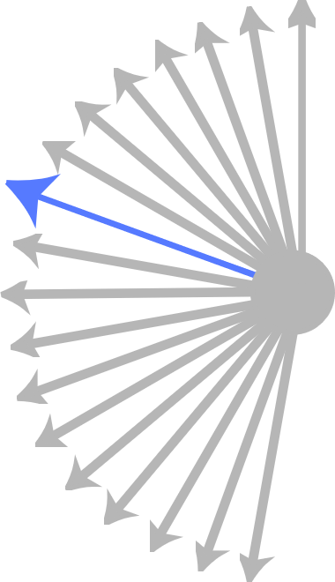
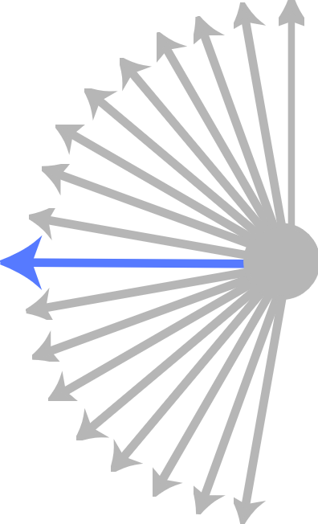
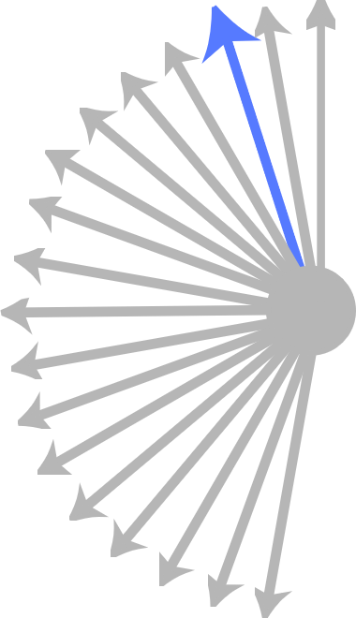
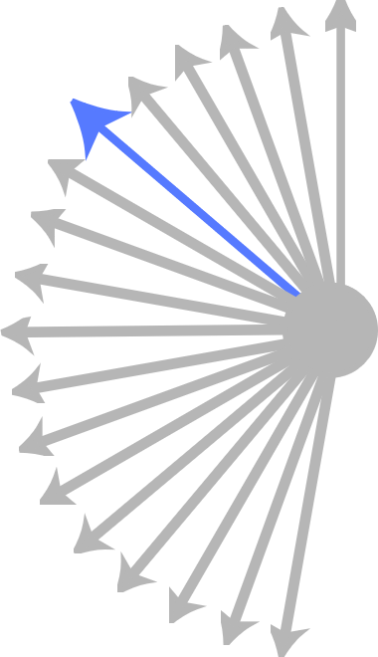
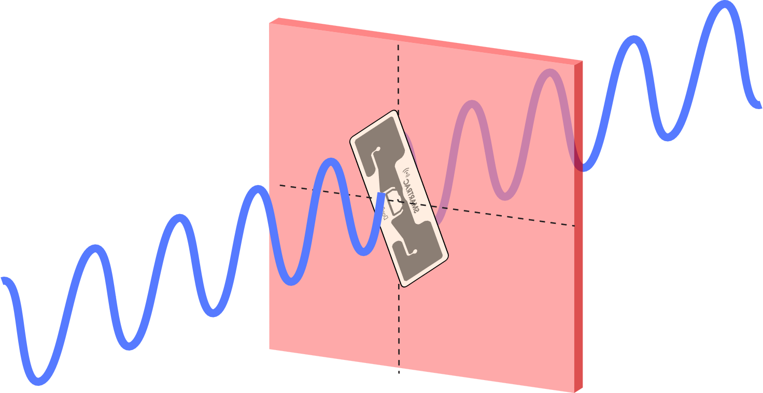
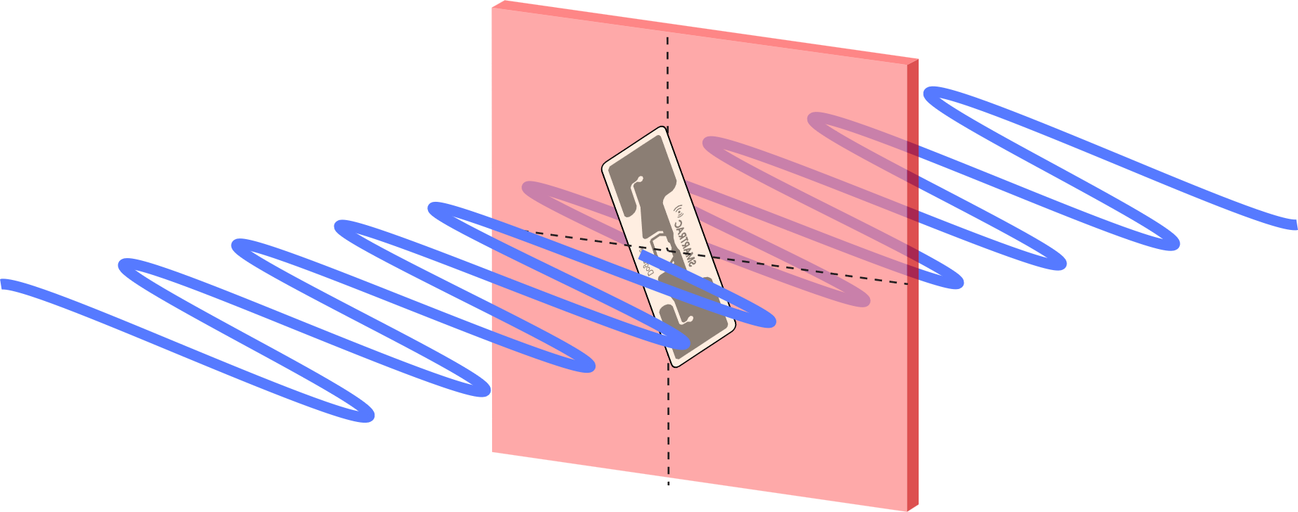
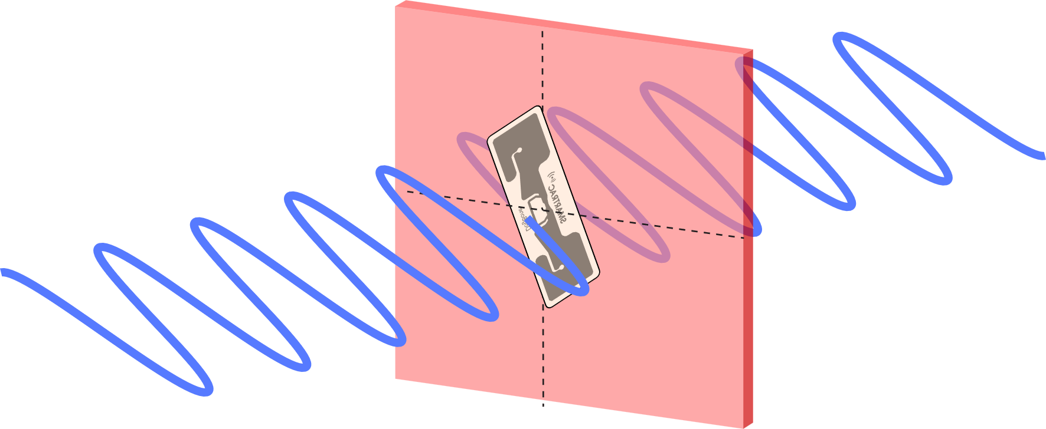
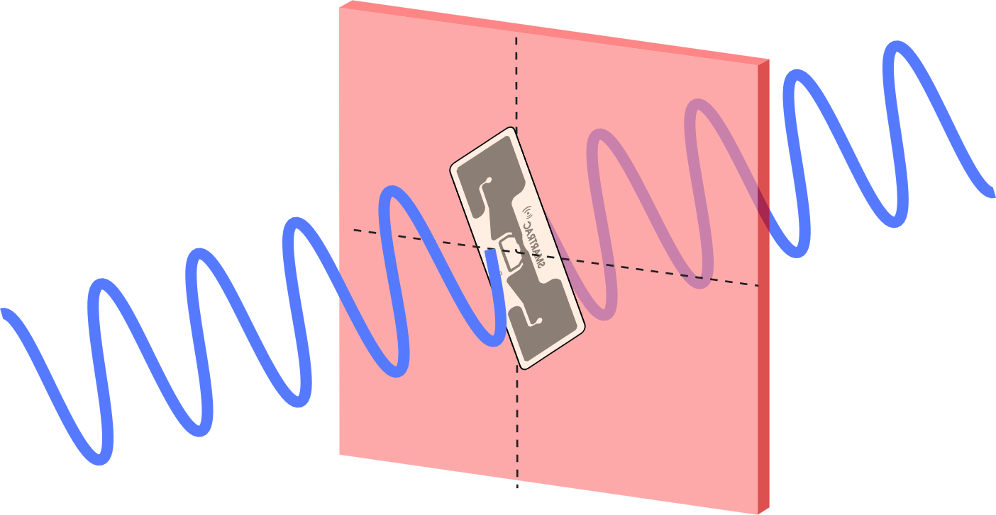
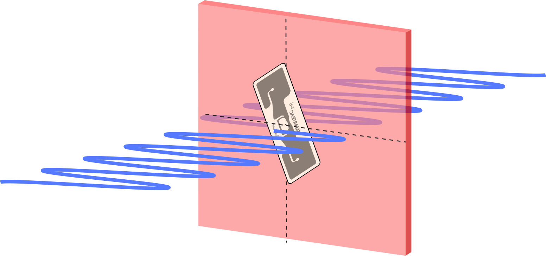
Solution: Efficient Tag Discovery
Sweep transmit angle over time to read all tags
EPC Gen 2
RFID Discovery
Current angle
All possible angles

Slide 7
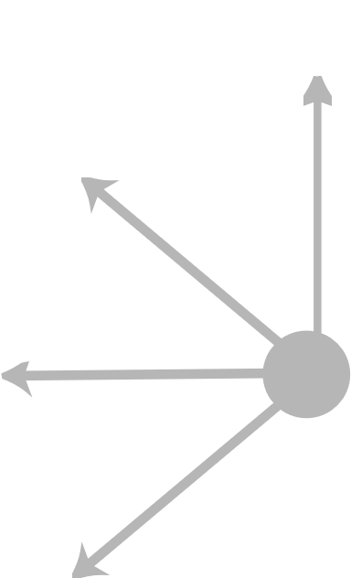
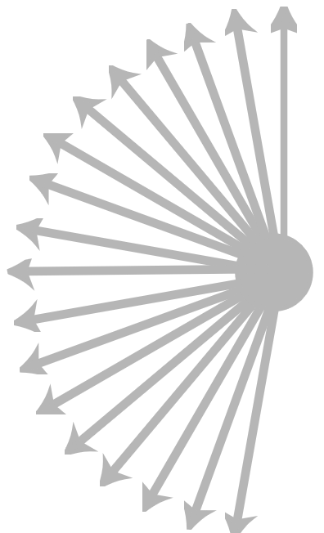
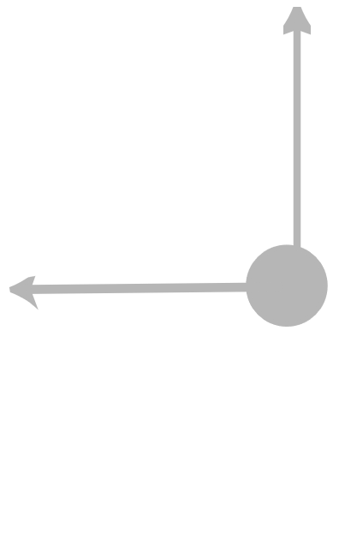
How many angles do we need?
Low polarization loss
High polarization loss
High latency
Low latency

Slide 8
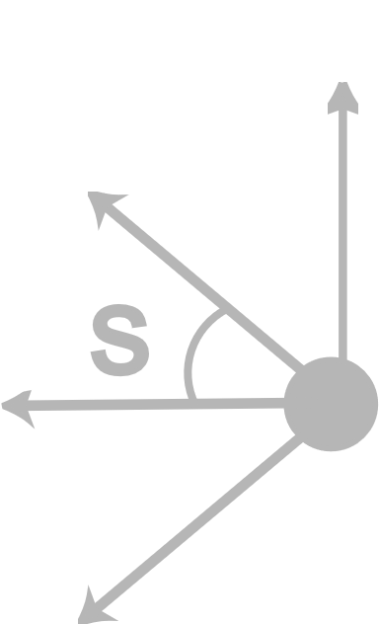
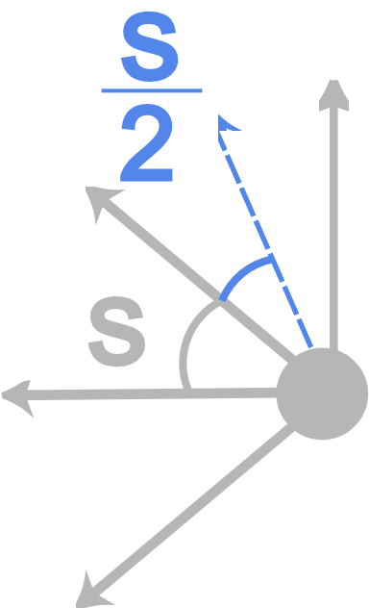

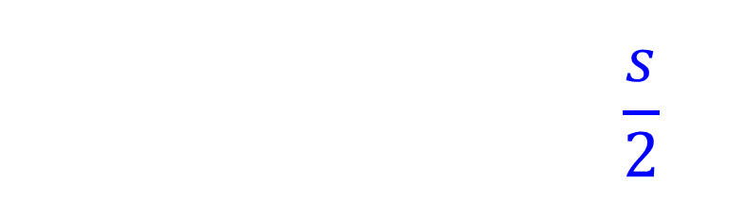
How many angles do we need?
Worst case: tag exactly
between two angles
$$PL=20\log_{10}\left(\cos^{2}\left(\frac{s}{2} \right)\right)$$

Slide 9

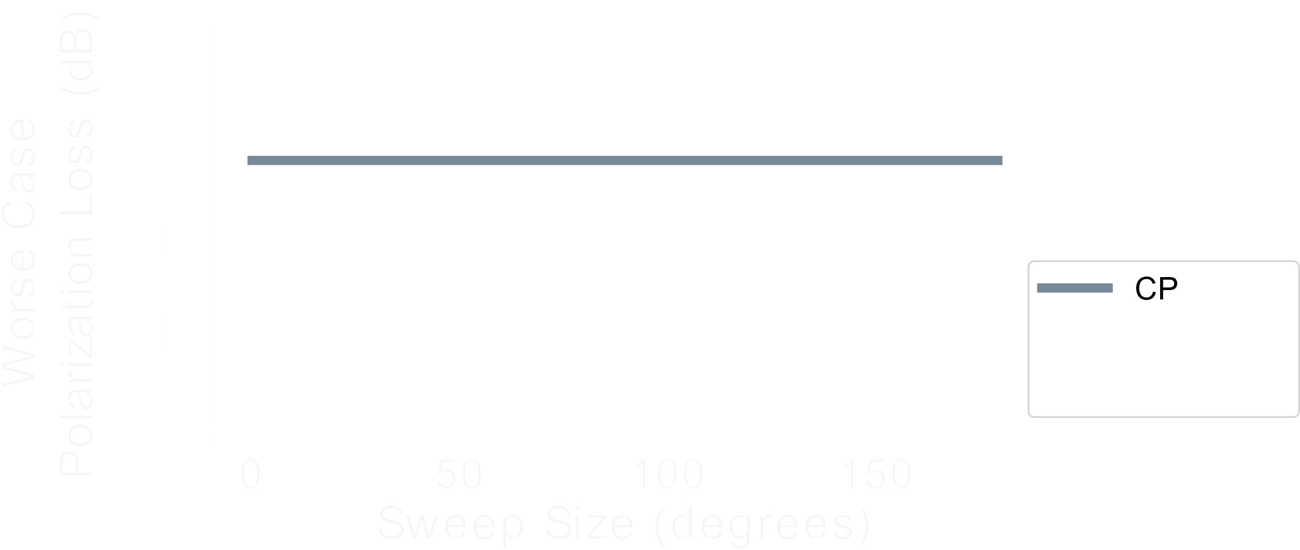
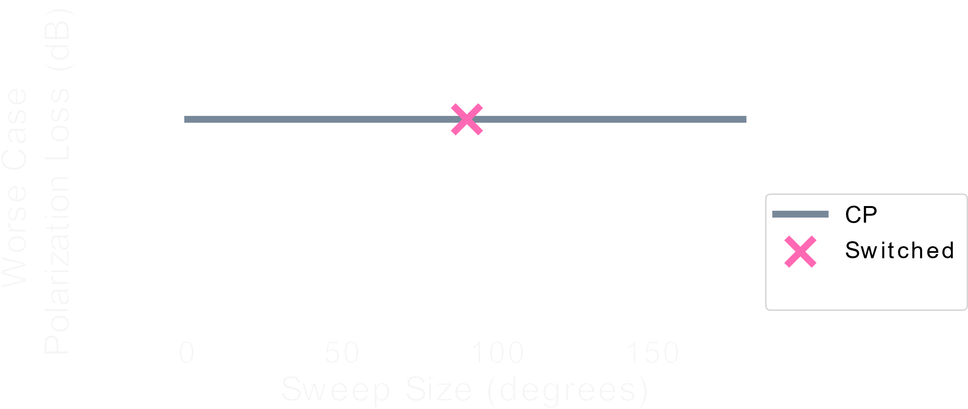
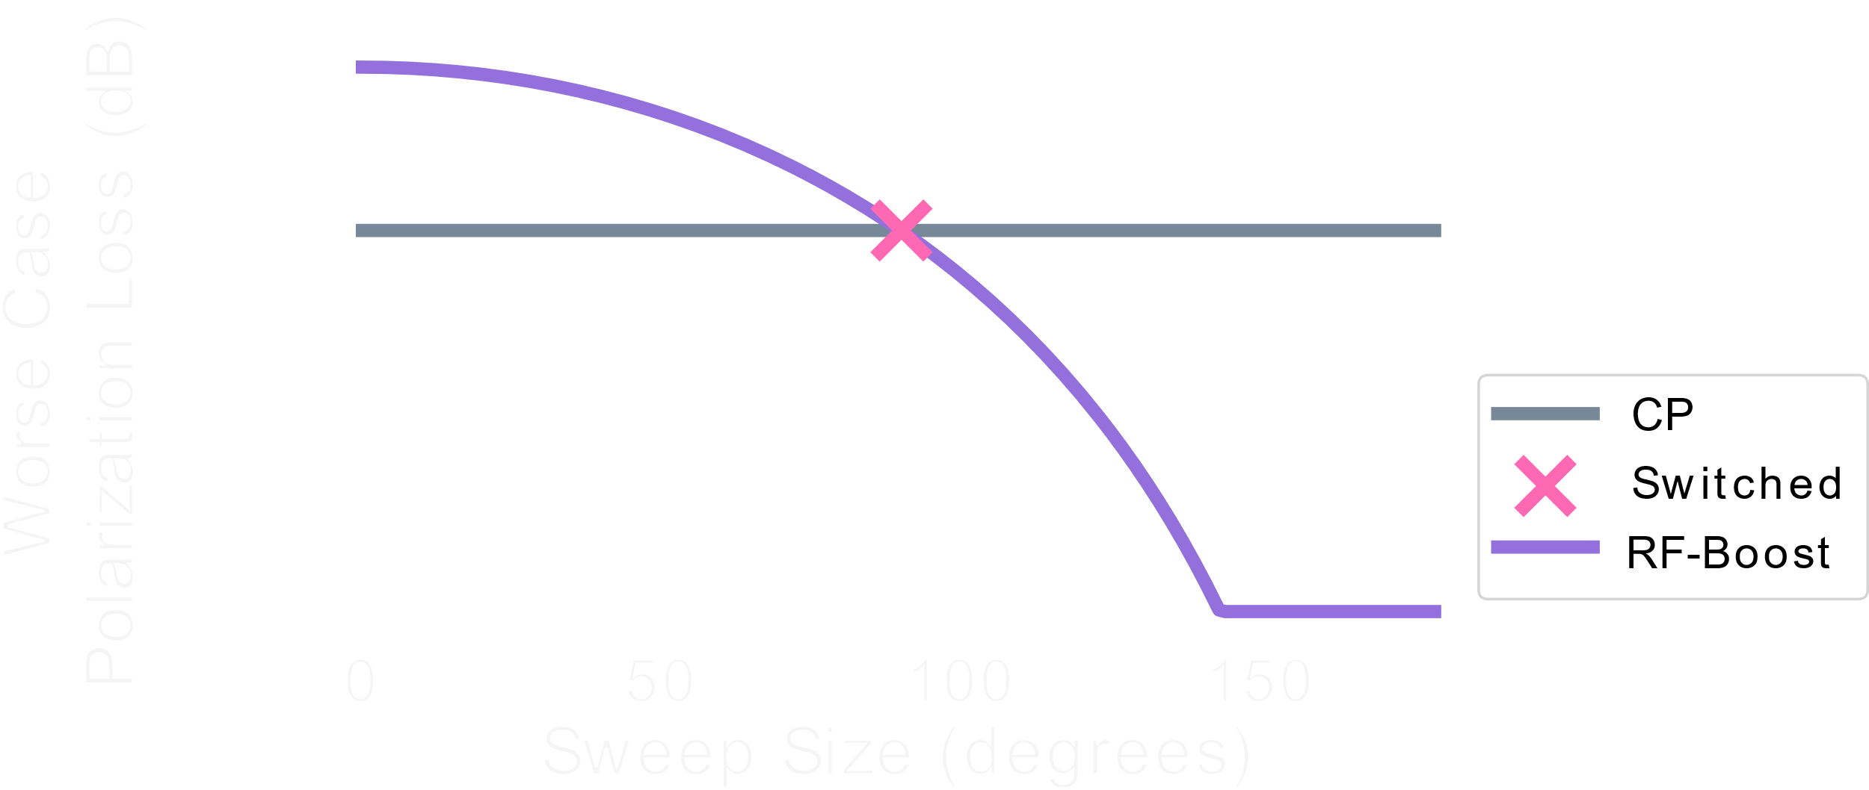
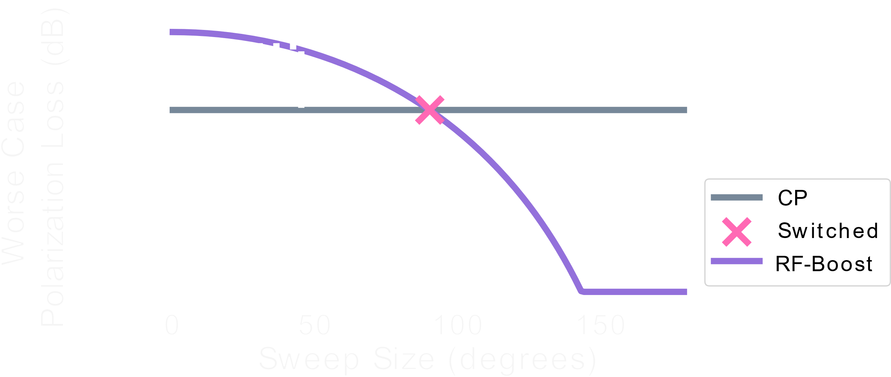


How many angles do we need?
<1.4dB loss
$$PL=20\log_{10}\left(\cos^{2}\left(\frac{s}{2}\right)\right)$$

Slide 10
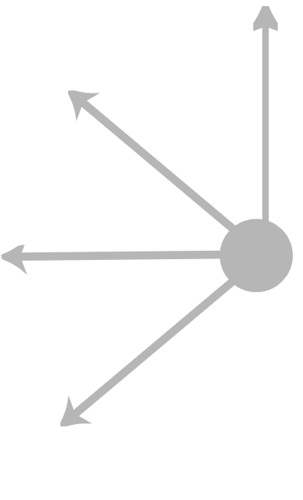
How many angles do we need?
Low polarization loss
Low latency

Slide 11

So far...
Read Range
State-of-the-Art
Read Range
RF-Boost

Slide 12
How can we extend the localization range?

Slide 13

Dual Frequency Excitation*
Standard RFID Reader
Wideband RFID Reader
Low-Power
Out-of-Band
In-Band
Insufficient bandwidth for cm-scale localization
Sufficient bandwidth for cm-scale localization
*Mobicom 2017

Slide 14
Long-Range Localization

Slide 15
So far...
Read Range
Localization Range
State-of-the-Art
Read Range
?
Localization Range
Localization Range
RF-Boost
Regulations limit out-of-band transmit power

Slide 16


How can we further extend localization range?
$$P_{R}=P_{T}G_{t}^{2}LΔσ$$
Limited by
regulations
Fixed
$$Δσ=\frac{λ^{2}G^{2}}{4π}{\left|Γ_{1}−Γ_{2}\right|}^{2}$$
Fixed

Slide 17



How can we further extend localization range?
$$P_{R}=P_{T}G_{t}^{2}LΔσ$$
$$P_{R}$$
$$Δσ=\frac{λ^{2}G^{2}}{4π}{\left|Γ_{1}−Γ_{2}\right|}^{2}$$
$${\left|Γ_{1}−Γ_{2}\right|}^{2}$$

Slide 18
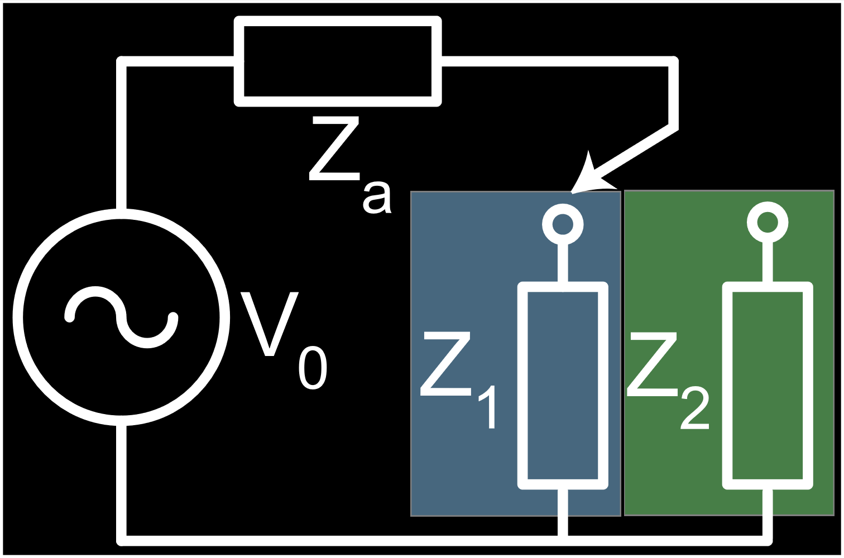



How can we further extend localization range?
Decreasing in-band power can increase
out-of-band SNR
$${\left|Γ_{1}−Γ_{2}\right|}^{2}$$
$$P_{R}$$
RFID Tag
V₀
$${\left|Γ_{1}−Γ_{2}\right|}^{2}$$
*
*IEEE T-MTT 2016

Slide 19
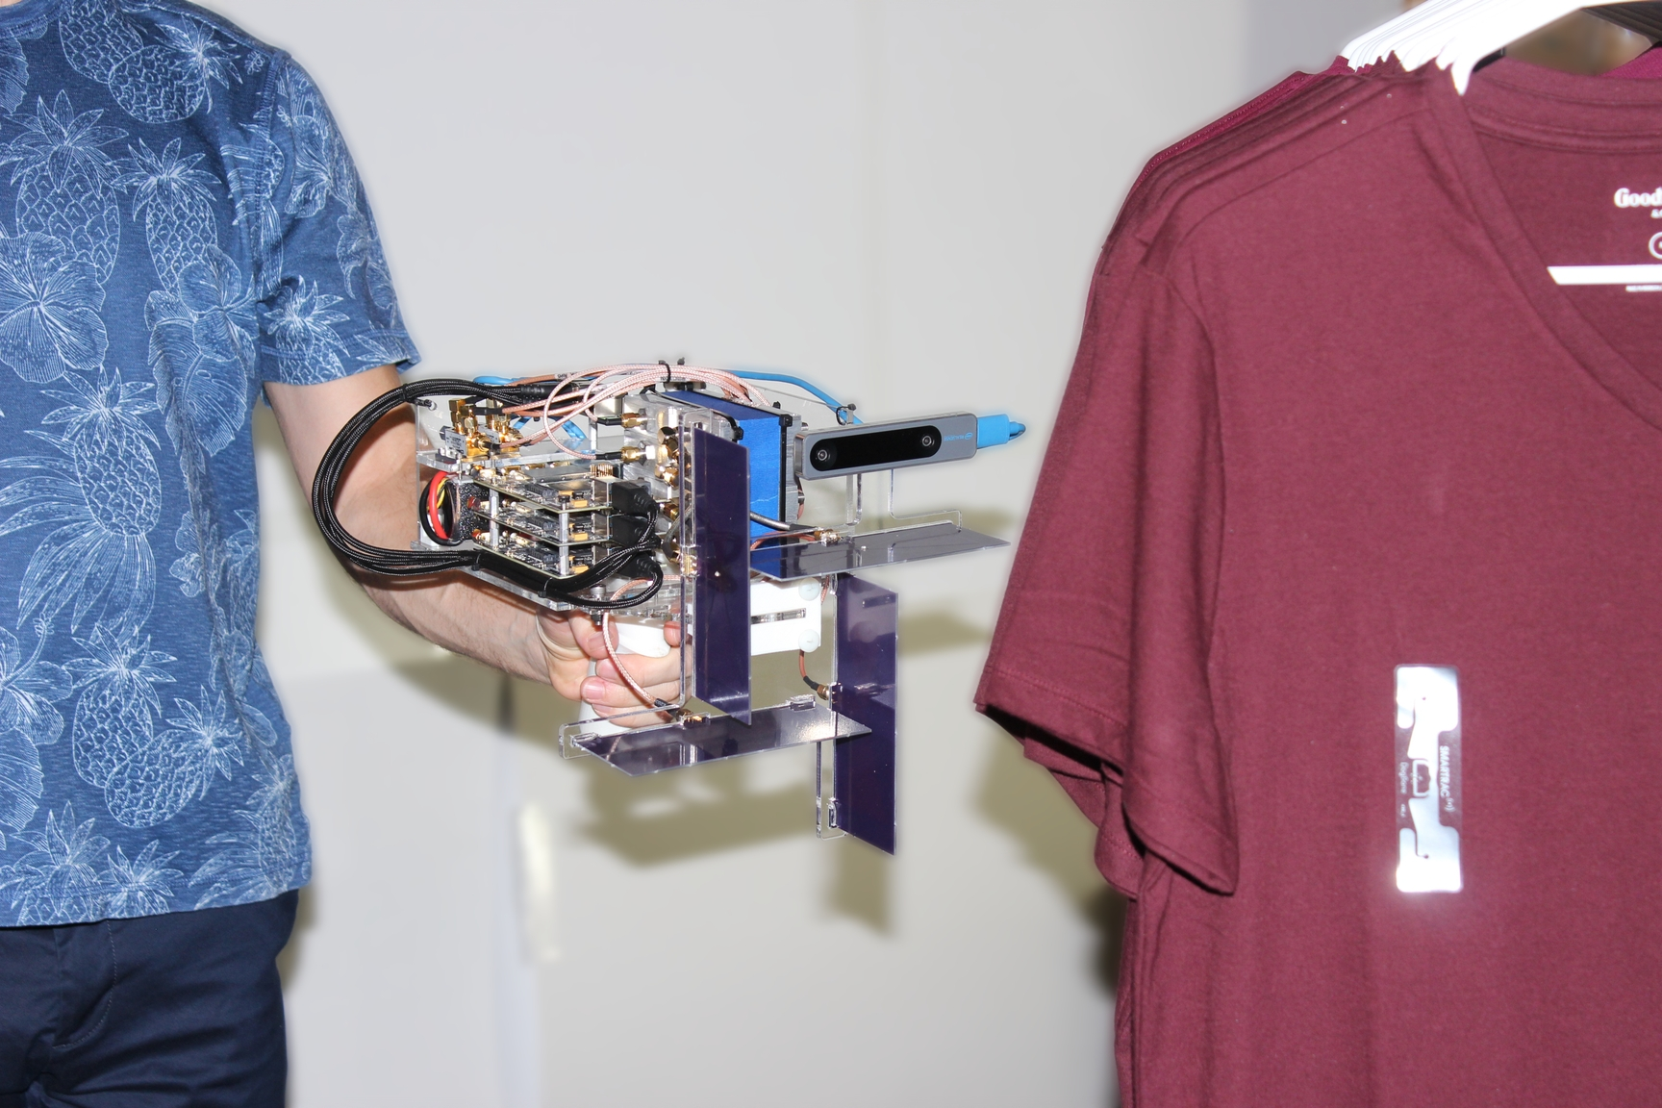
Implementation
BladeRF software defined radios to apply amplitude control
Raspberry Pi
EPC Gen 2 Protocol
Bowtie antenna*
Smarttrac RFID Tags
RFID Tag
Software
Defined
Radios
Antennas
*Mobicom 2023

Slide 20


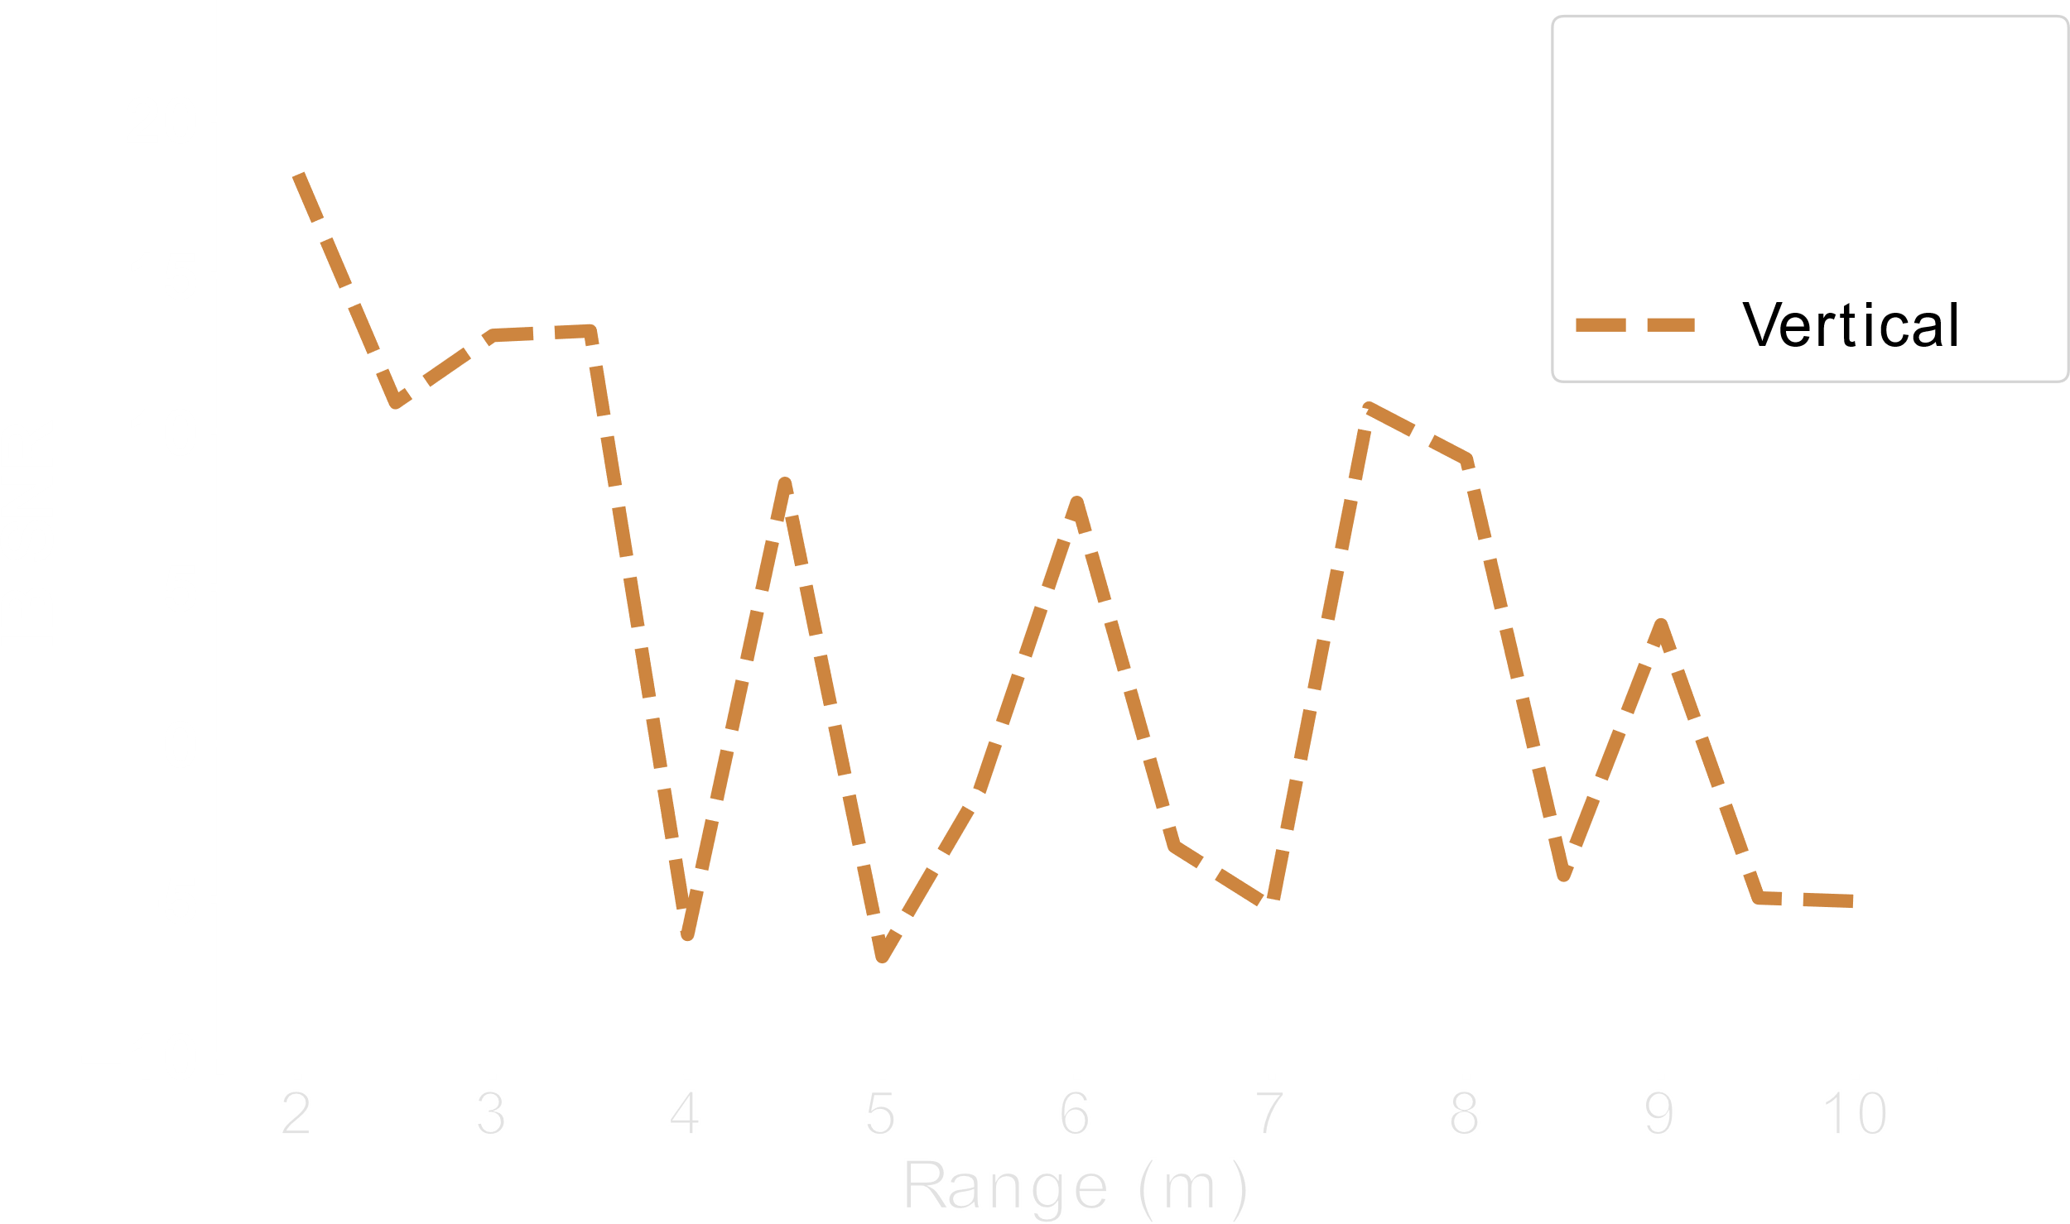
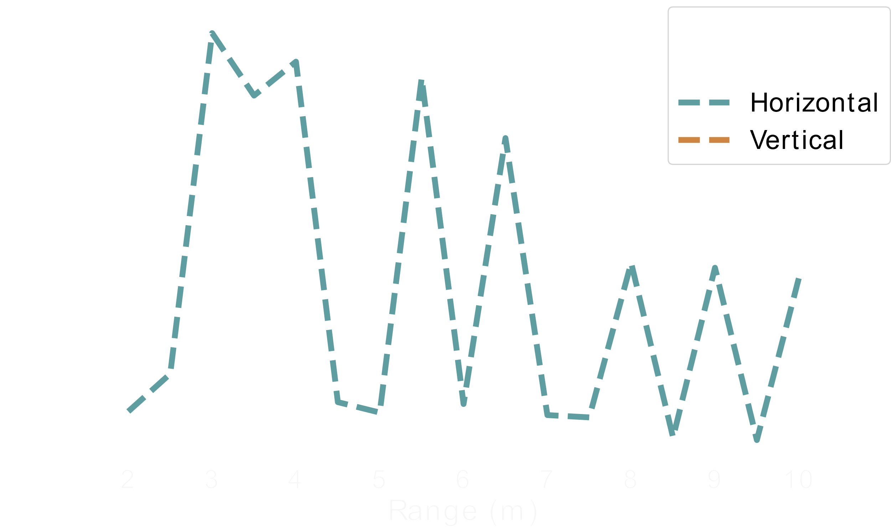
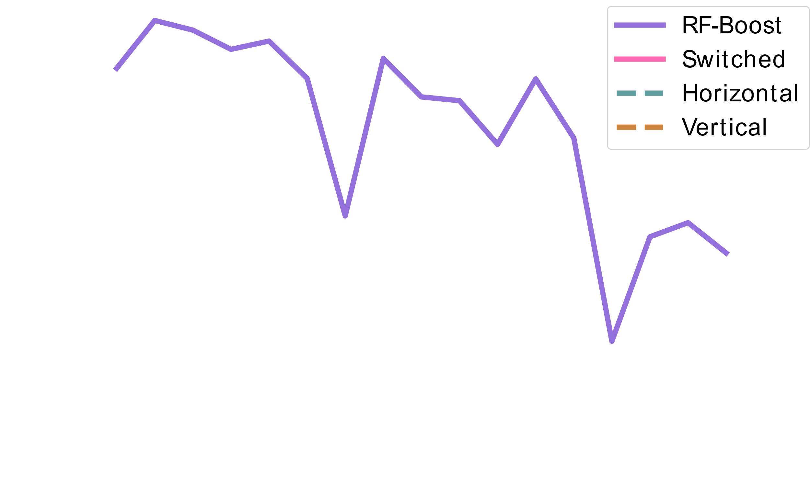
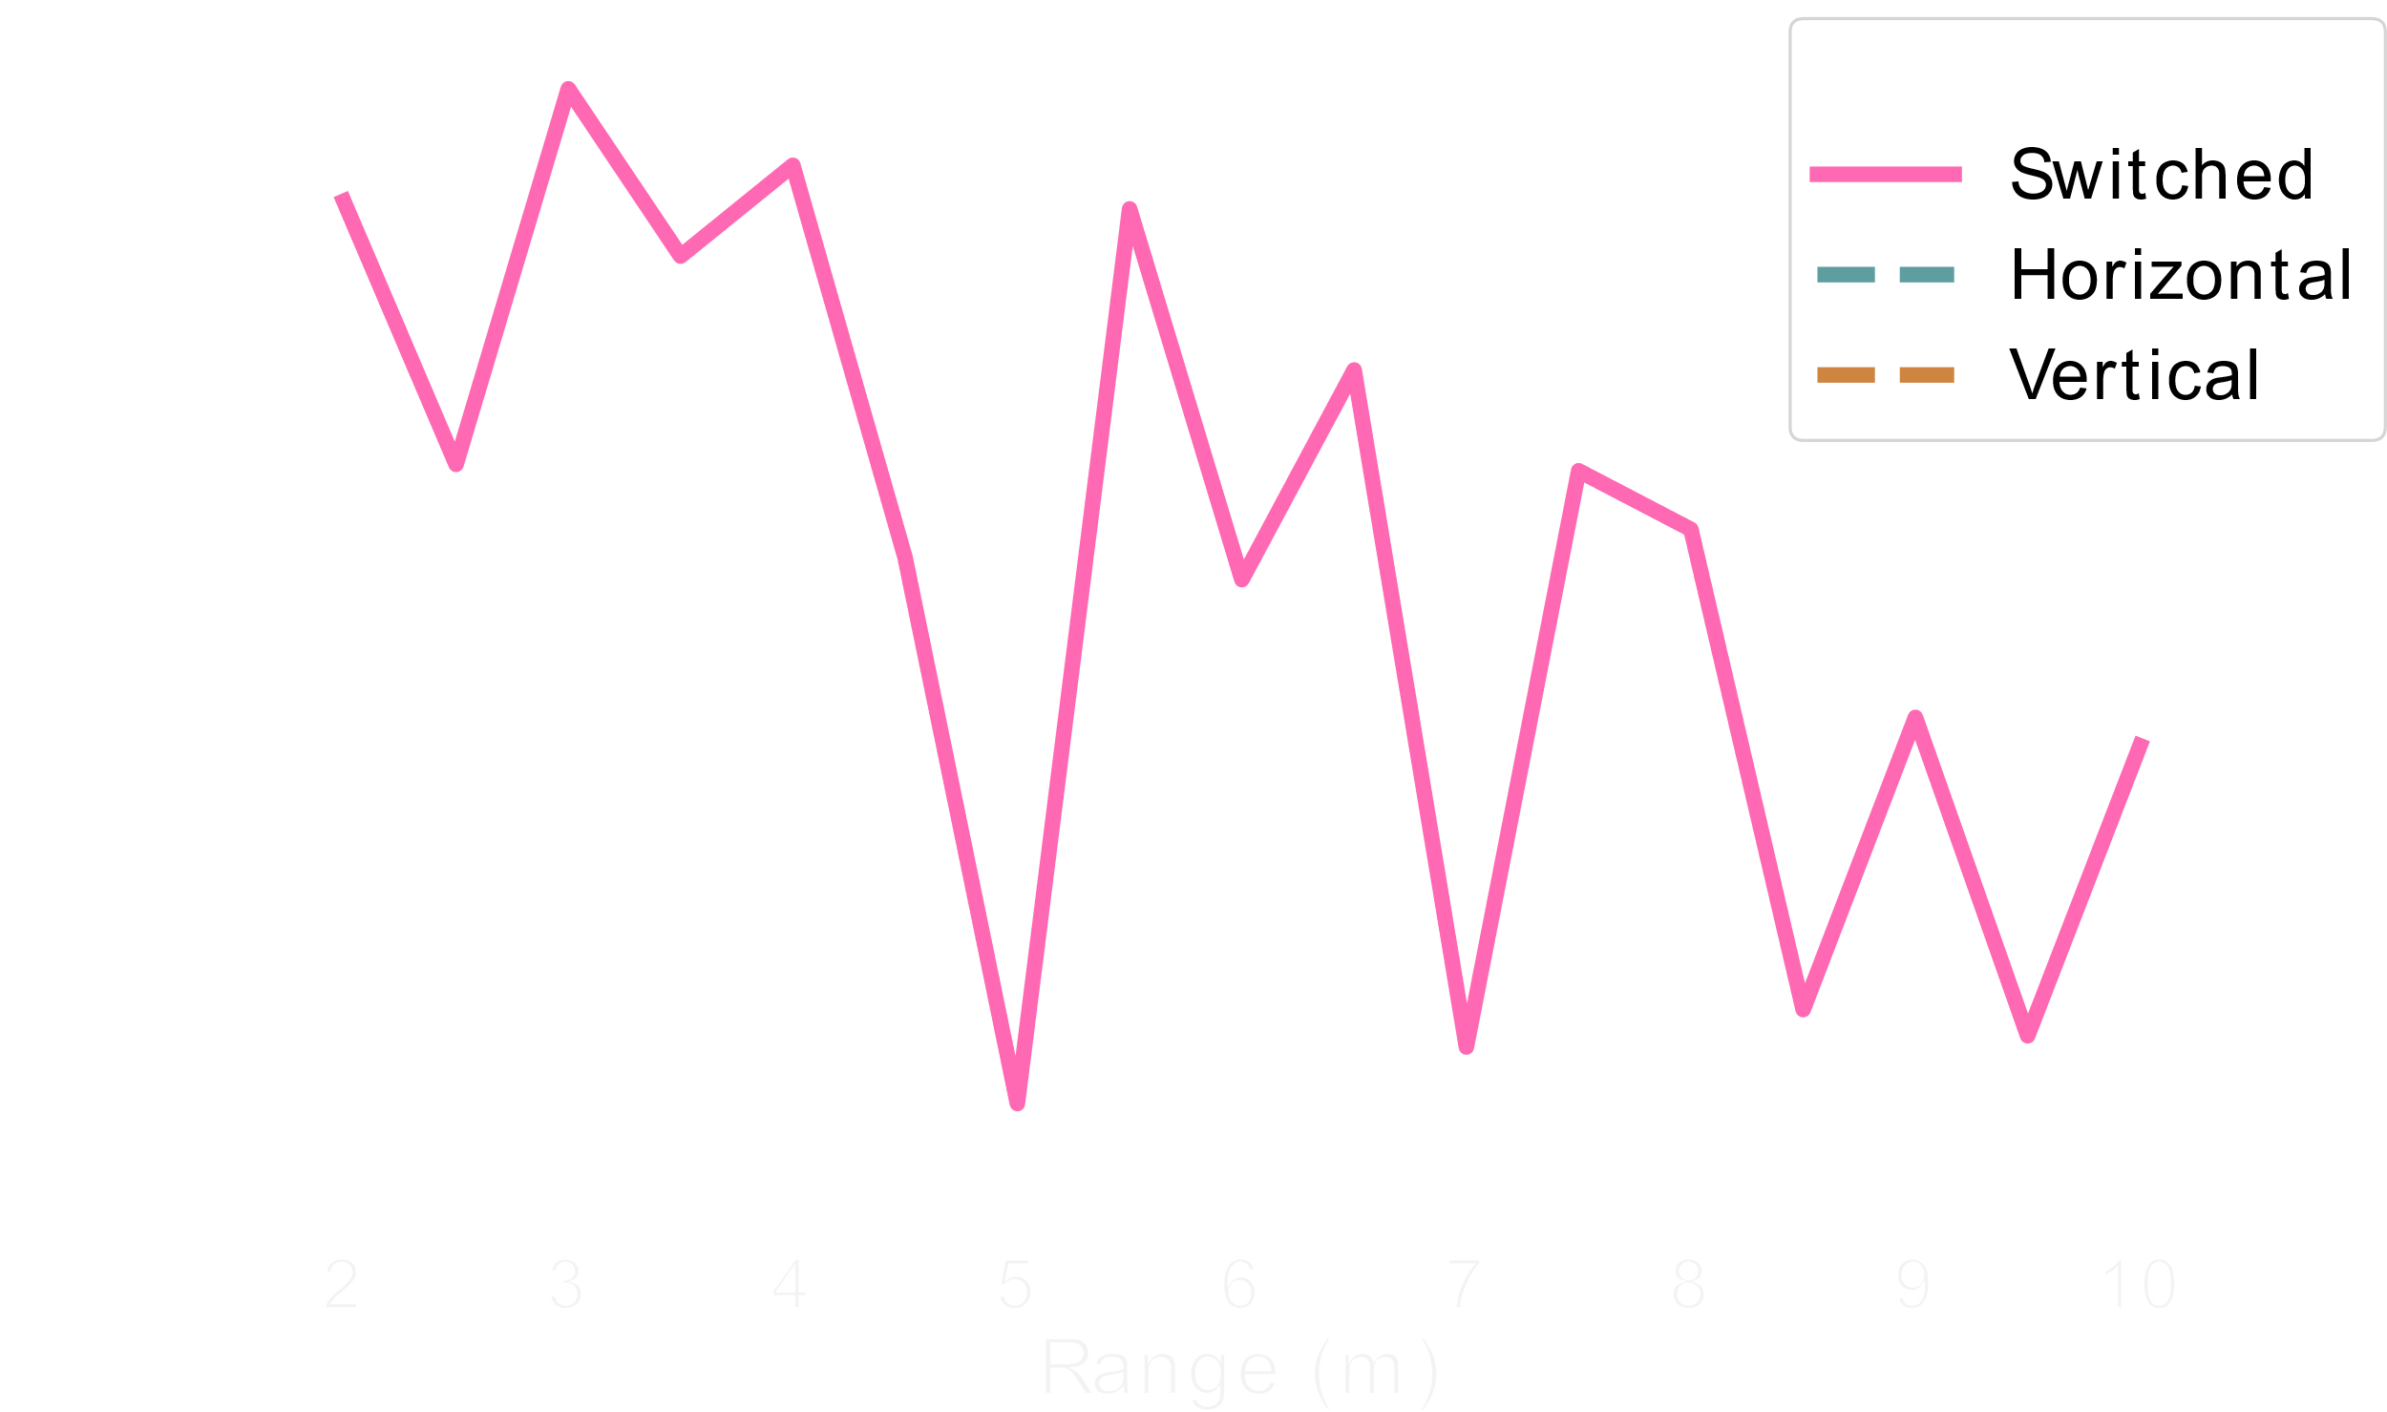
In-Band SNR vs Range
Placed tag at 45°
Measured SNR of tag response at different ranges
(dB)

Slide 21
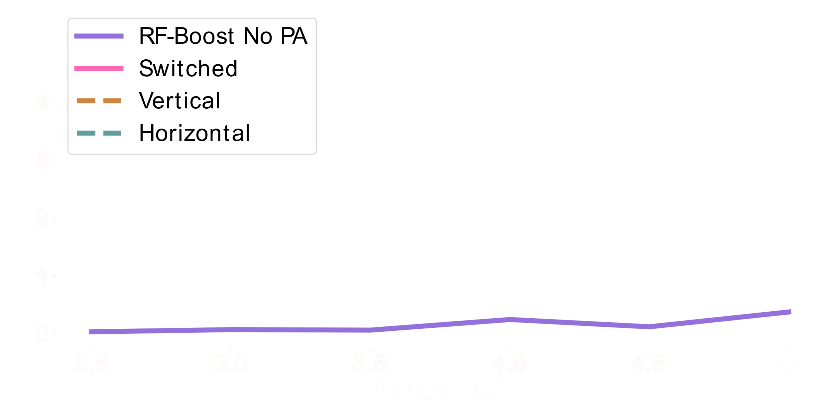


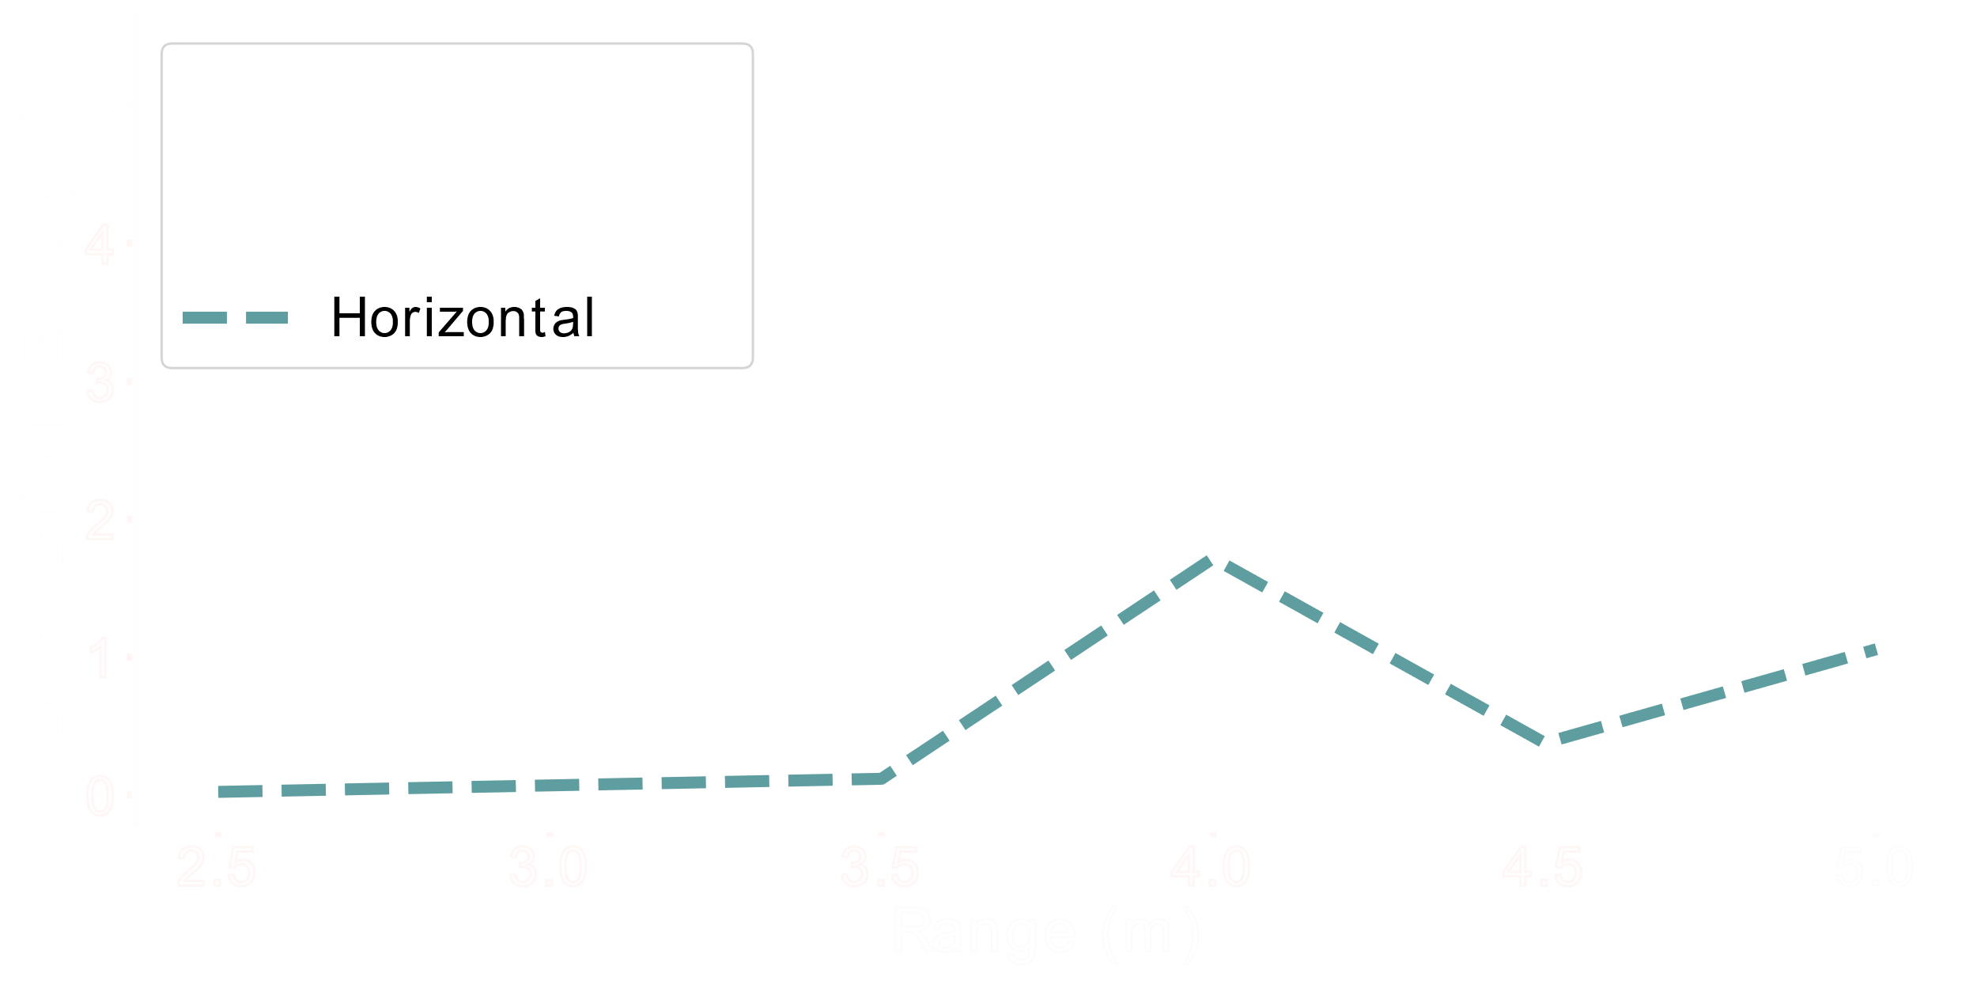
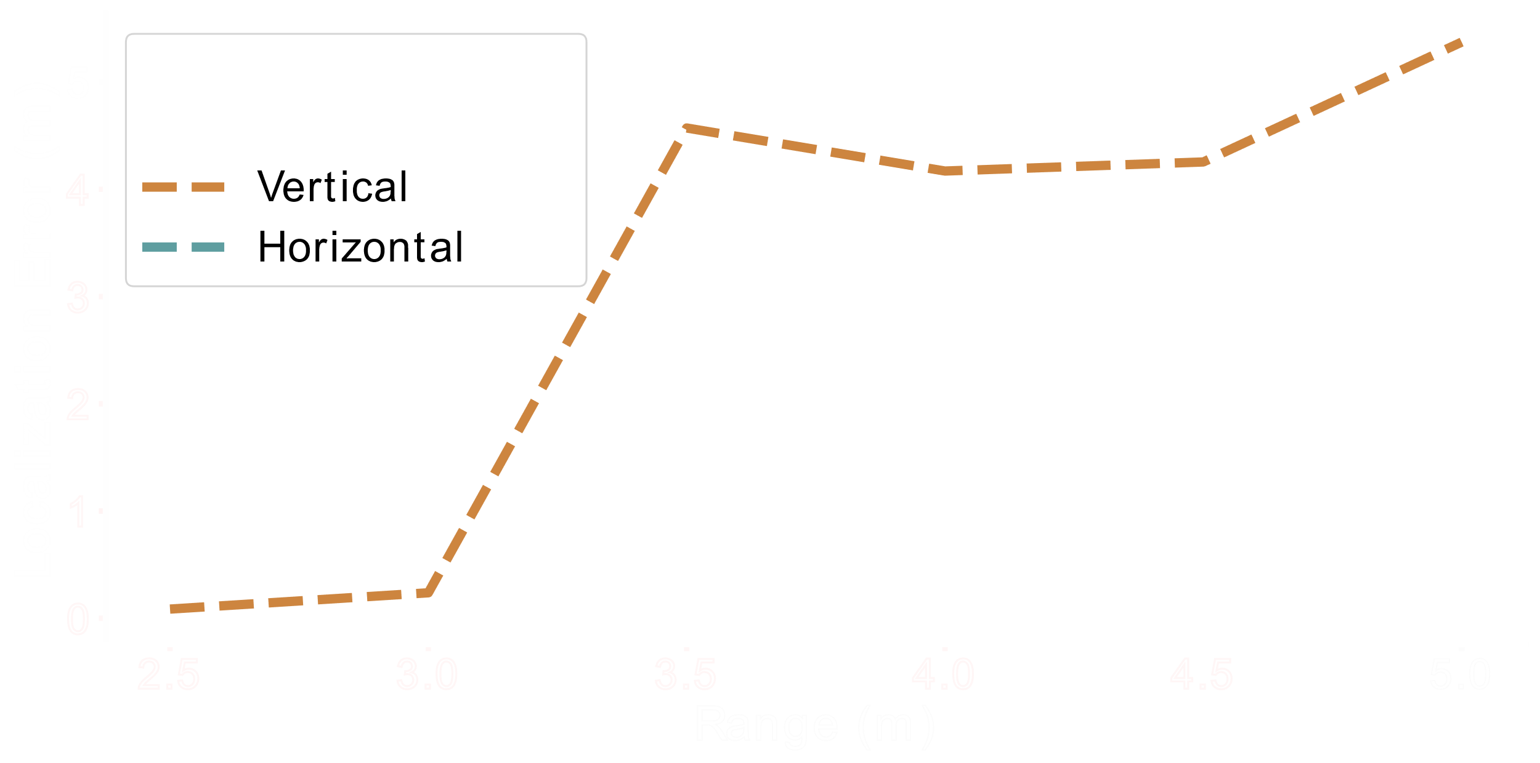
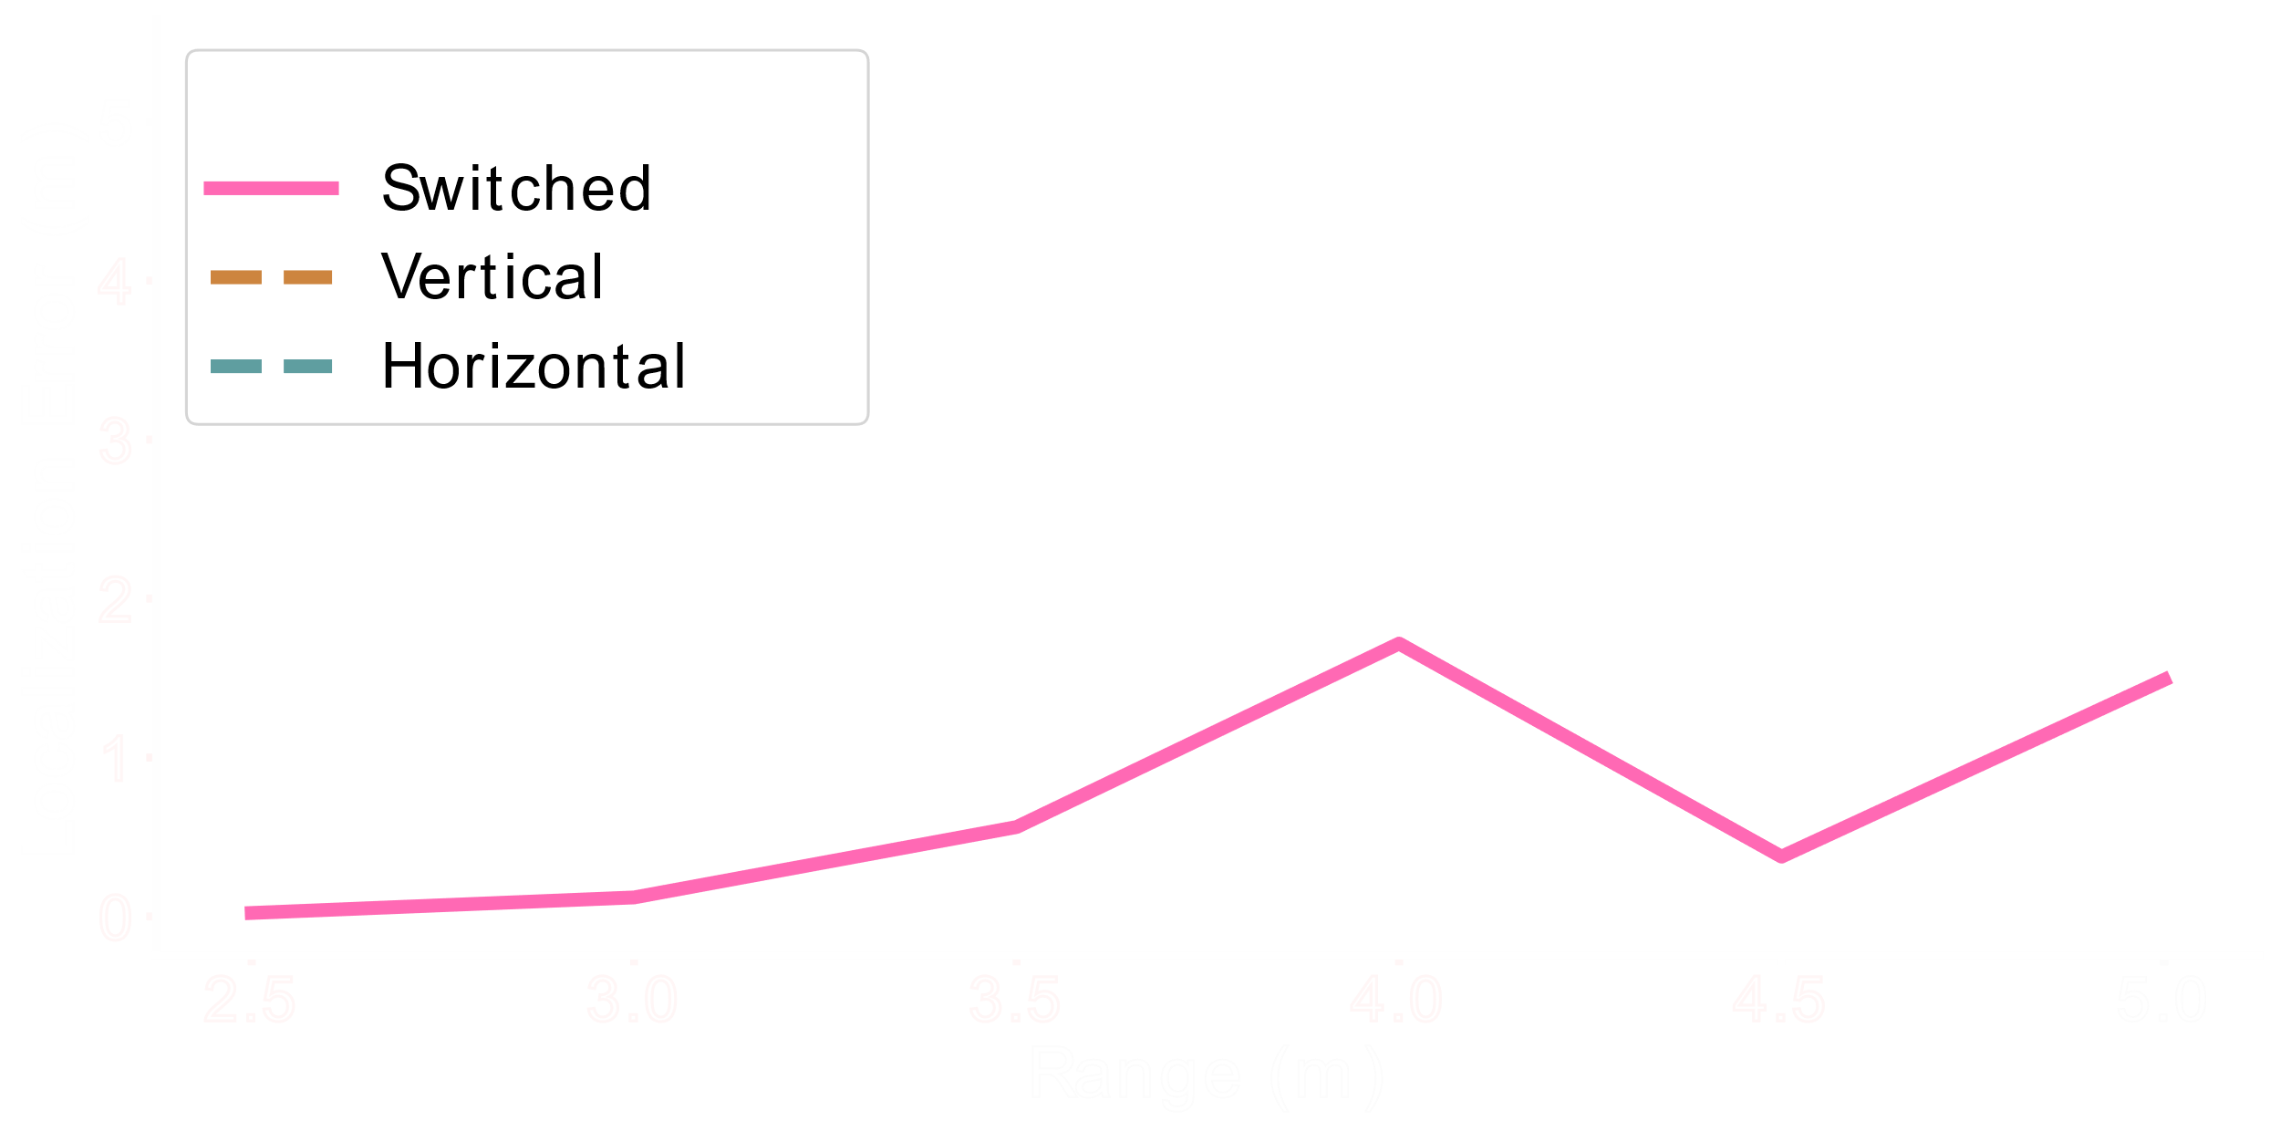
Localization Range
Placed tag at 45°
Measured 1D localization error at different ranges

Slide 22


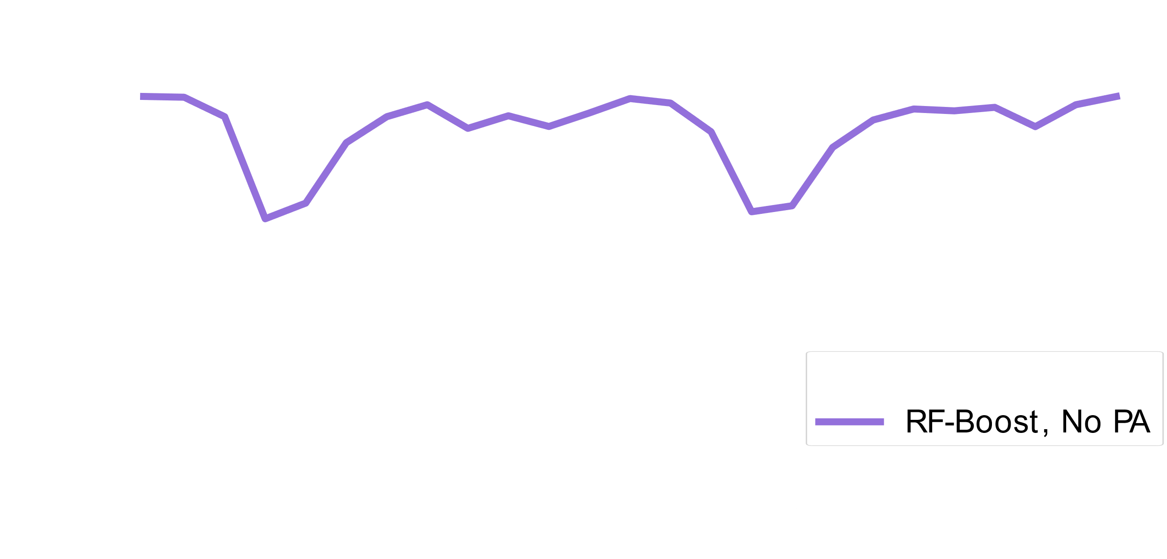

Dynamic Power Adaptation
Rotated tag from 0° to 360°
Measured out-of-band SNR with and without power adaptation (PA)
(dB)
2.7dB Improvement

Slide 23
Conclusion
Software controlled polarization for extending RFID read and localization range
Built technique into an efficient discovery algorithm
Reduce blind spots by 4x and boost SNR by 6dB
Boost cm-scale localization range by 1.3x

